Slide 1

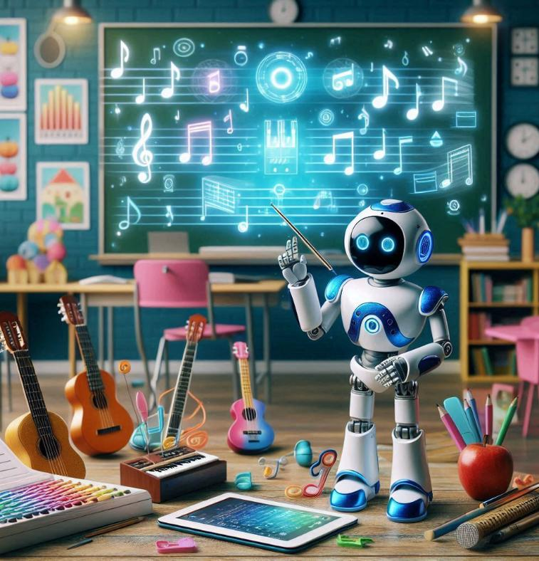


AI and Music
TRAILS.scot
Notes:
This lesson assumes that students have a general idea of what “generative AI” is.

Slide 2






What makes music original?
TRAILS.scot
Notes:
Have your students think about this for a minute or two, and then proceed with the videos.

Slide 3



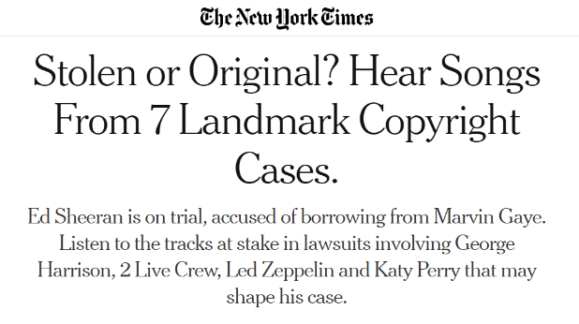
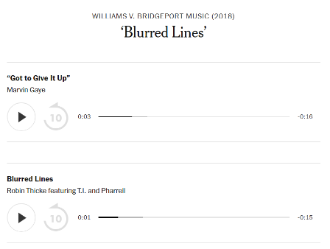


Were the songs “original”? Or were they ripping each other off?
Sometimes musicians accuse others of infringing on their copyright! Let’s have a listen to some of these…
For each pair of songs consider:
Do you think this is a valid copyright claim?
Was this an intentional copy?
NEW YORK TIMES
TRAILS.scot

Slide 4



How many melodies are there?
Copyrighting all the melodies to avoid accidental infringement | Damien Riehl | TEDxMinneapolis
TRAILS.scot
Notes:
Watch the first 5min 20s for an introduction to the concept.

Slide 5





How many melodies are there?
Damien and Noah algorithmically generated all 8 notes melodies and put them on a hard drive – meaning that by law they own them.
Does the fact that the melodies were algorithmically generated alter how much they own them?
Should anyone “own” a melody? Is there a certain length of melody that this should kick in for?
TRAILS.scot

Slide 6


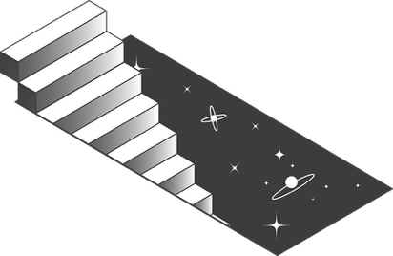
What about music generated by AI?
Click the notes to hear examples of AI generated music
There are many AI tracks being made and released now that this is a possibility.
What if an artist has a copyright claim over AI generated music? Is this different from the case of making a claim over other humans?
TRAILS.scot

Slide 7
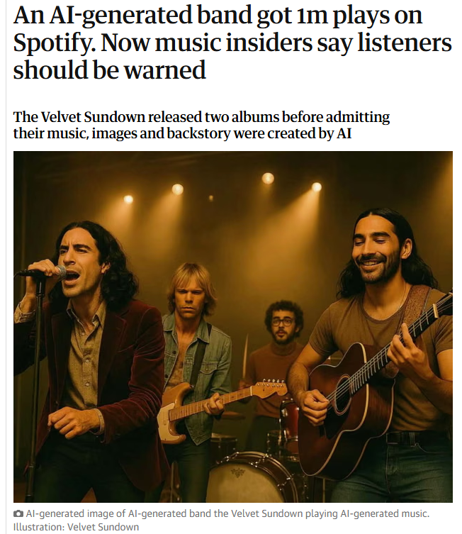

AI Music and Artists
TIKTOK
The article to the right discusses the AI band “Velvet Sundown” releasing two albums and getting millions of streams without explicitly being labelled as AI.
This TikTok video shows an artist talking about how an AI artist has been created on Spotify, releasing a similar style of music as them and the same name. To the right we see an example of this AI artist’s music.
TRAILS.scot

Slide 8


In your class, put your hands up if you think it’s okay to use an AI tool to create music:
For a friend’s birthday to make them smile.
As a part of a school project presentation, to educate about a particular topic.
To use as background music for your YouTube video.
To use in an advertisement for your product.
To put on Spotify and earn money through listens.
TRAILS.scot

Slide 9

End of slides

