Slide 1



Critical Thinking with AI
TRAILS.scot
Notes:
Overall Aim: To develop students' critical thinking skills through engagement with AI and the evaluation of AI-generated responses.

Slide 2

Learning Intentions
Success Criteria
Understand the ways AI can be used to develop critical thinking
Explore AI tools that support analysis and critical thinking
I can evaluate the reliability of an AI response
I can create counter arguments to AI responses
TRAIL.scot

Slide 3



Starter Task
What are some current controversial topics? Create a mind map.
Let’s choose one.
TRAILS.scot
Notes:
Teacher Guide:
Present the starter task: "What are some current controversial topics?".
Facilitate a brainstorming session, encouraging students to suggest various controversial issues. Consider examples such as Free speech, Death sentence, Global warming, Gun control, and Abortion. Create a mind map of issues based on student suggestion to model different options.
Guide the class to choose one controversial topic for further exploration.
Reference for controversial topics: 601 Controversial Research Topics & Questions for Students | Blog StudyCorgi

Slide 4
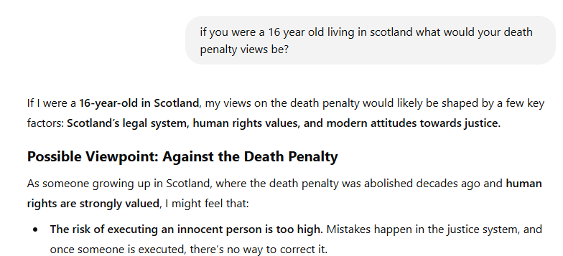
For our chosen topic we are going to probe an AI chat and observe an effective method of questioning.
If you think of any questions for the chat then raise your hand!
TRAILS.scot
Notes:
Teacher Guide:
Introduce the activity of probing an AI chat about the chosen controversial topic.
Model an effective initial question on your teacher device, such as the example provided: "if you were a 16 year old living in Scotland what would your death penalty views be?". Emphasize the importance of specific framing.
Show the example AI response and discuss the factors it considers (Scotland's legal system, human rights values, modern attitudes towards justice).
Encourage students to "think of any questions for the chat then raise your hand!". Facilitate a process where students suggest follow-up questions to delve deeper into the AI's reasoning and potential biases.
Suggested AI tools include: MagicSchools AI, ChatGPT, Copilot, Gemini, Brisk

Slide 5

In Social Subjects we often discuss war.
Use the following prompt:
You are in control of an army and have two options. Your goal is to take control of country A. It would be cheaper and quicker to harm people and use violence. It would be more expensive and more time consuming to use democracy and peace. What would you choose? Violence or democracy?
Notes:
Teacher Guide:
Introduce the war scenario and the prompt on screen..
Ask students to input this prompt into an AI and note the response.
Suggested AI tools include: MagicSchools AI, ChatGPT, Gemini

Slide 6
Try to make some changes to the prompt:
Add a third option
Describe the country. Have they started the war?
Ask the AI not to make a choice but to recommend one using political theory or historical actions.
Notes:
Teacher Guide:
Instruct students to modify the trolley problem prompt as noted on the slide.
Encourage students to observe how these changes in the prompt affect the AI's response and the complexity of the dilemma.

Slide 7
Discussion:
Is this ethical?
Should humanity use AI to solve moral problems?
What problems could AI solve in the future?
What problems could AI create?
Notes:
Teacher Guide:
Facilitate a class discussion around the ethical implications of AI and moral decision-making using the following questions:
Is this ethical? (Referring to AI solving moral problems)
Should humanity use AI to solve moral problems?
What problems could AI solve in the future?
What problems could AI create?
Encourage diverse perspectives and critical analysis of AI's role in ethical, moral and political dilemmas.

Slide 8
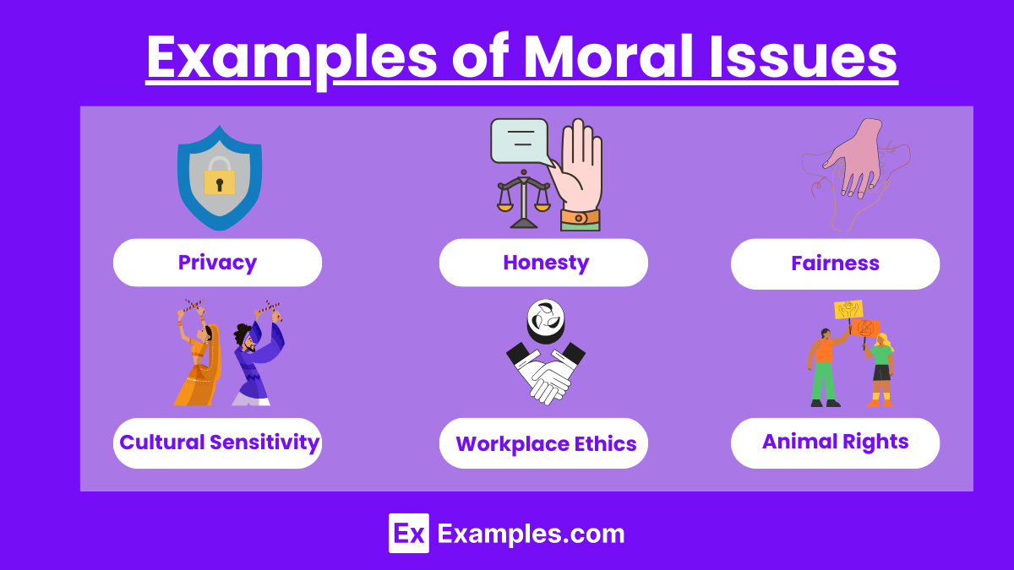
RESOURCE TITLE
Task: United Nations Report
You are going to write a report to the United Nations. This report will:
Begin with an introduction explaining the use of AI
Include the advantages of using AI
Include the disadvantages of using AI
Conclude if AI is a reliable way to solve moral problems
02
03
04
TRAILS.scot
Notes:
Teacher Guide:
Introduce the task of writing a report to the United Nations on AI and moral problems.
Clearly outline the required components of the report:
Begin with an introduction explaining the use of AI.
Include the advantages of using AI.
Include the disadvantages of using AI.
Conclude if AI is a reliable way to solve moral problems.
The report should be completed individually and teachers should allow between 15-25 minutes depending on lesson time. This could be completed over the entirety of a learning period if the timetable permits. AI can be used to create the report however this must be checked and sourced. The report should be around two pages of A4 long if written or around 800 words if typed.
You may want to briefly discuss examples of moral issues, such as those shown on the slide (Privacy, Honesty, Fairness, Cultural Sensitivity, Workplace Ethics, Animal Rights).

Slide 9
RESOURCE TITLE
Extension Task: United Nations Report
Take your UN report and let an AI chat read it!
Ask for feedback.
Trying asking the AI for specific support.
Ask about skills such as knowledge, evaluation and analysis.
Consider: can you trust this feedback?
02
03
04
TRAILS.scot
Notes:
Teacher Guide:
Introduce the extension task: getting feedback on their UN report from an AI chat.
Instruct students to ask the AI for feedback, encouraging them to ask for specific support and about skills such as knowledge, evaluation, and analysis.
Prompt students to consider: "Can you trust this feedback?", reinforcing the need for critical evaluation of AI output.

Slide 10
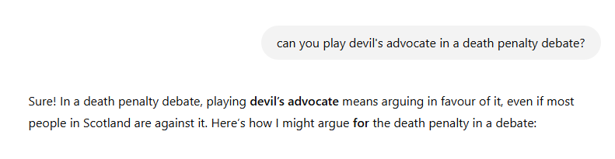
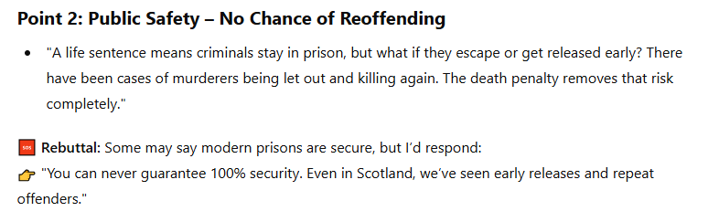
To finish choose any debate topic. Engage the AI in a friendly debate about this issue.
Ask the AI specifically to play the other side.
Could AI replace human debate in the future?
Notes:
Teacher Guide:
Instruct students to choose a debate topic.
Guide them to engage an AI in a debate about this topic, specifically asking the AI to play the other side of their own argument. The slide shows an example of asking the AI to play devil's advocate in a death penalty debate.
After the debates, lead a final discussion on the potential for AI to replace human debate in the future.
Suggested AI tools include: MagicSchools AI (debatebot), Brisk

