Slide 1
Atlantis
Island
Did you manage to run an AI business?
… and did Atlantis fall?

Slide 2
Choose your own discussion…
Do we need to use
so much data
How much power does an AI server need?
Swimming pools heated by servers? Really?!
Should we use AI?
Where does the data come from?
Where should we put data centres?
Is nuclear power safe?
Do AI servers really need that much water?
Who owns the data?
How much data do
AI systems need?
Should governments restrict the use of AI?
Do undersea data centres exist?
Why can’t we use sea water?
Is Atlantis real???
Where can we get the power for AI and data centres?

Slide 3
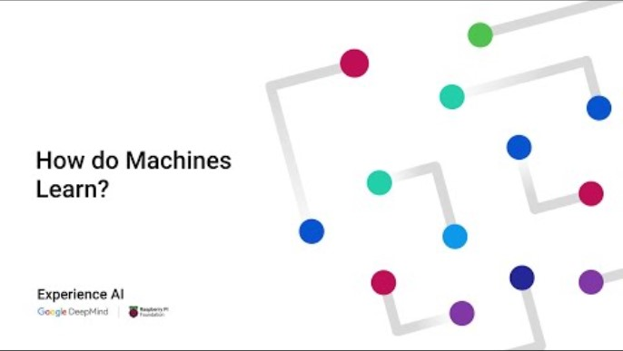
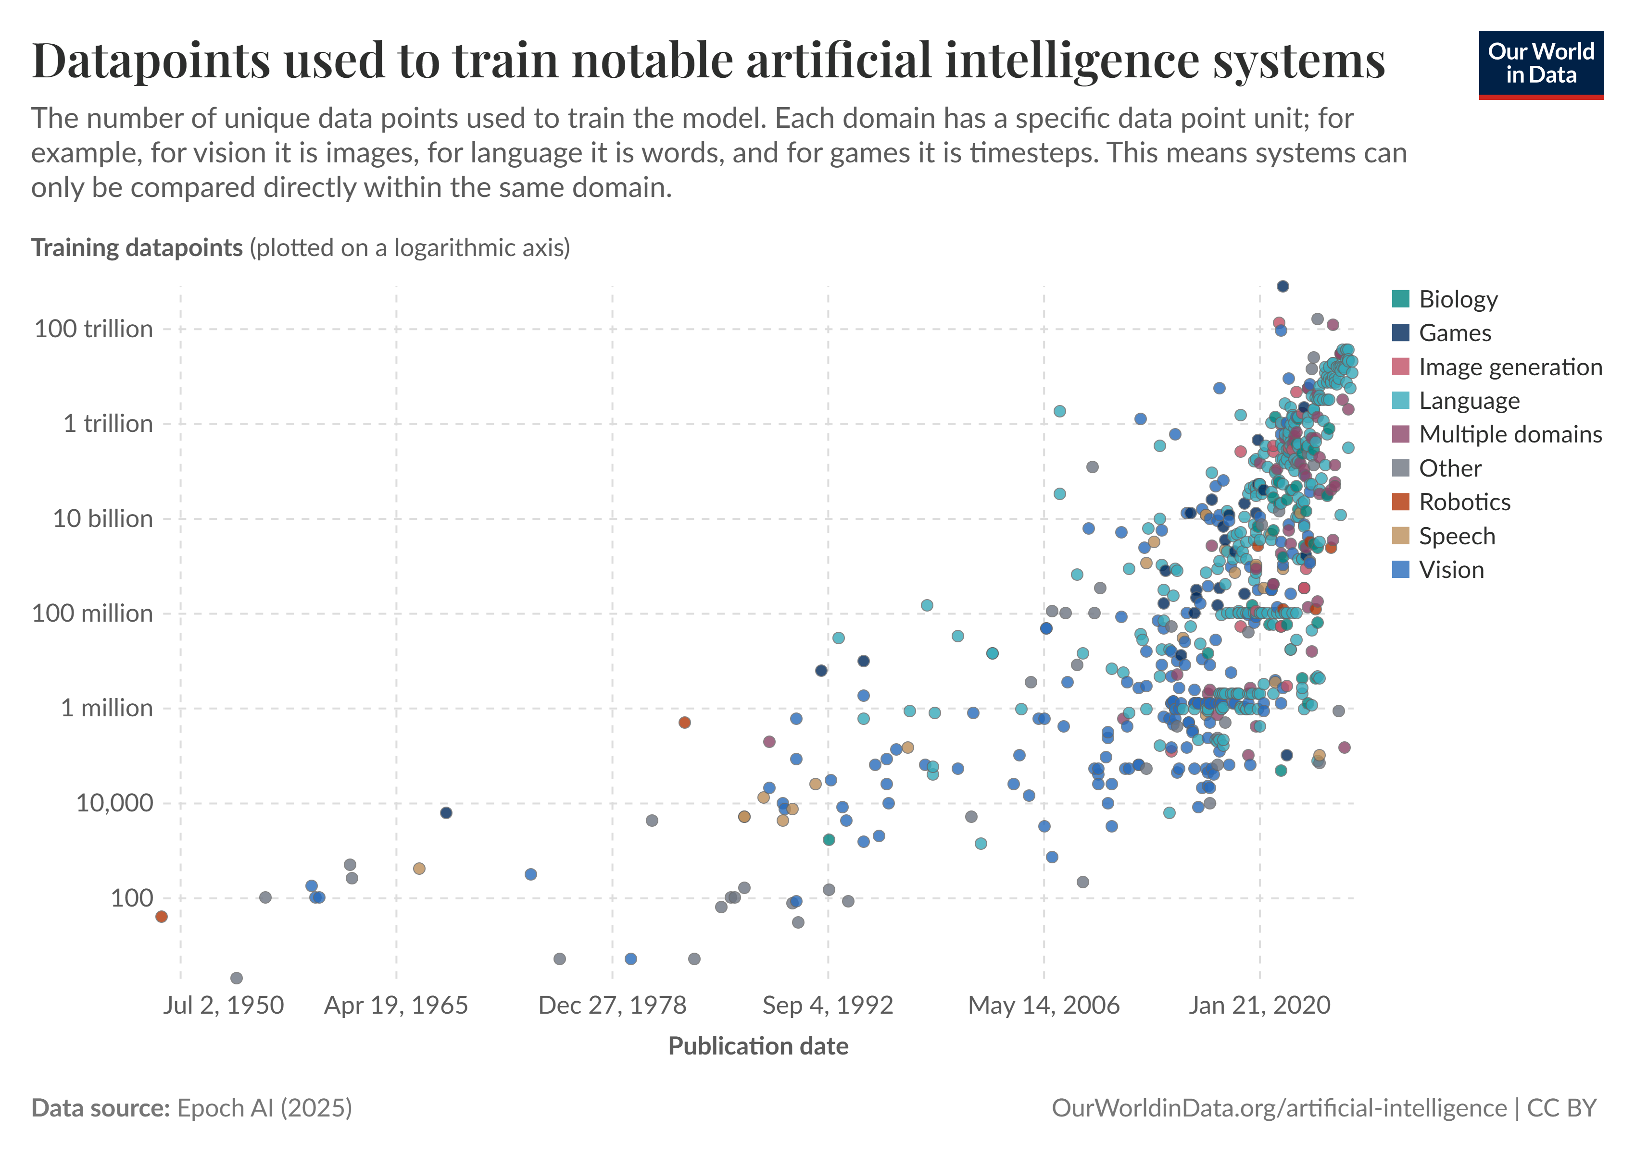

How much data do AI systems need?
This depends on the AI system and what it’s trying to do.
Machine Learning (ML) is a type of AI that focuses on teaching machines to learn from data.
AI uses huge amounts of data for training systems (‘Our World in Data’ article)
What is machine learning and how does it use data? (4 min)
4 min video on how machines learn using data
Where does the
data come from?
Who owns the data?
Do we need to use
so much data?
Back to the questions
Notes:
Possible project: What types of AI systems can you think of? What data would they need?

Slide 4

Do we need to use so much data?
Do we need immediate access to our photos?
What are the benefits of storing our files “in the cloud?”
Could we reduce our personal data use?
8 min video on issues of
data centres in Ireland
Where does the
data come from?
Who owns the data?
Should we use AI?
Back to the questions

Slide 5

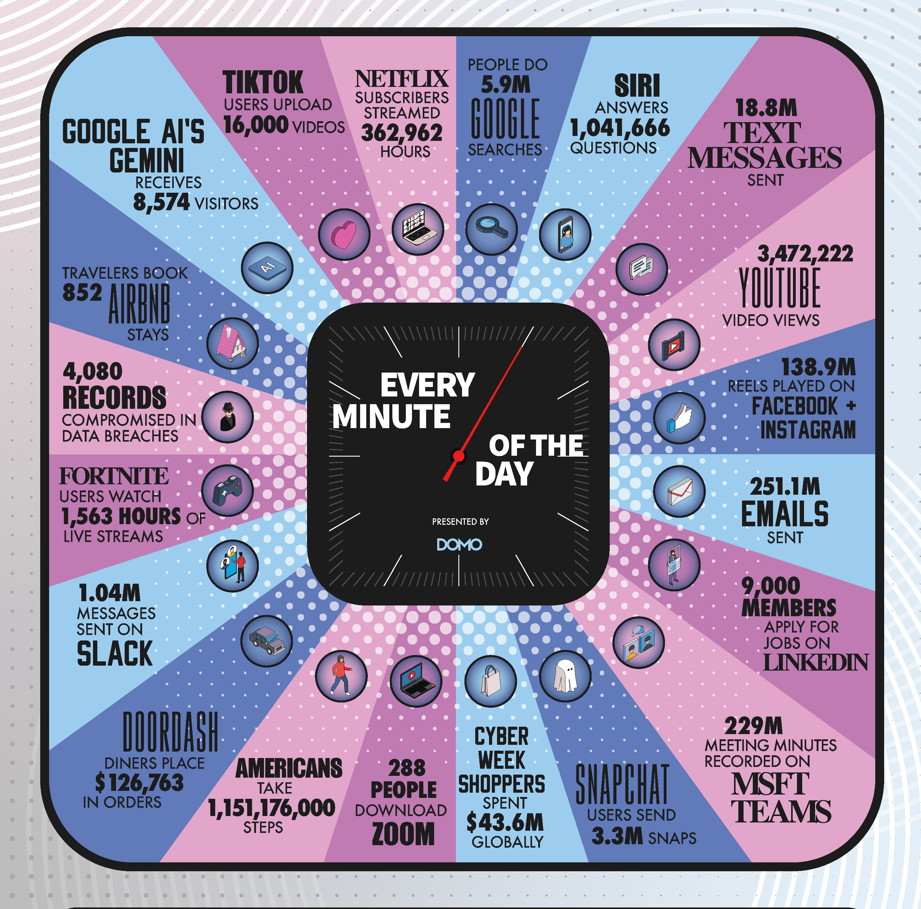
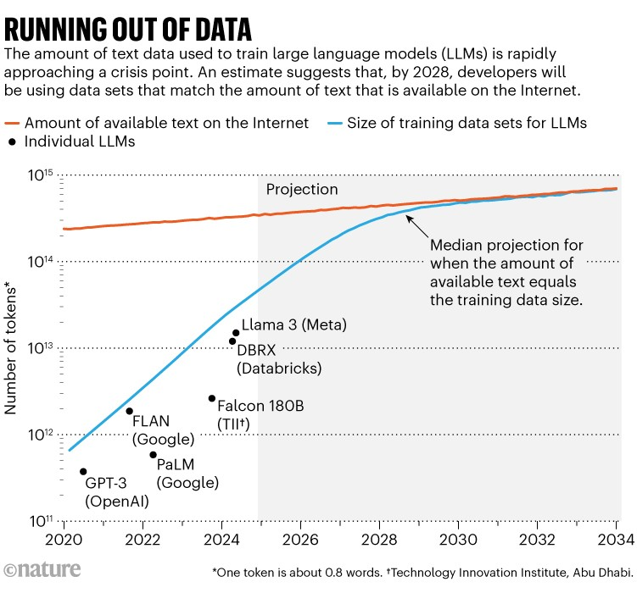
Where does the data come from?
How do AI systems ‘learn’ from data?
Where do the AI developers get the training data?
The amount of data uploaded every minute is huge
…but the AI revolution is still running out of training data
(Nature article)
3 min video on training data and bias
How much data do
AI systems need?
Who owns the data?
Should we use AI?
Back to the questions
Notes:
Nature article is a bit high level, but this is the source of the graph

Slide 6



Who owns the data?
Who is the ‘creator’ of a work
generated by AI?
Is it the the original authors, artists and
creatives of the training data?
Is it the developers of the AI systems?
Is it the people writing the AI prompts?
Has your data been used for
training AI systems?
Have I Been Trained website for searching popular AI training datasets
Scientific American article on personal data in training AI
12 min video on who owns AI art
How much data do
AI systems need?
Where does the
data come from?
Should we use AI?
Back to the questions
Notes:
Scientific American article is high level but might support a discussion on this issue?

Slide 7

Should we use AI?
What are the benefits of
using AI systems?
What are the negative
issues of using AI?
Do the benefits outweigh the environmental impacts of using AI?
Why AI matters – and what WE can do to help (2 min)
Issues with
AI (5 min)
Should I feel guilty using AI (35 min)
Where does the
data come from?
Should governments
restrict the use of AI?
Do we need to use
so much data?
Back to the questions

Slide 8

Should governments restrict the use of AI?
Government have a tough balancing act… develop AI systems slower so that we can identify issues with them
…without being left behind in the race to develop new AI systems.
25 min video on how to legislate AI in policing, elections, social scoring, nucear wars and possible critical systems disasters
Engineering Responsible AI: advice on sustainable AI policy
4 min video on EU’s AI law
Where does the
data come from?
Do we need to use
so much data?
Should we use AI?
Back to the questions

Slide 9



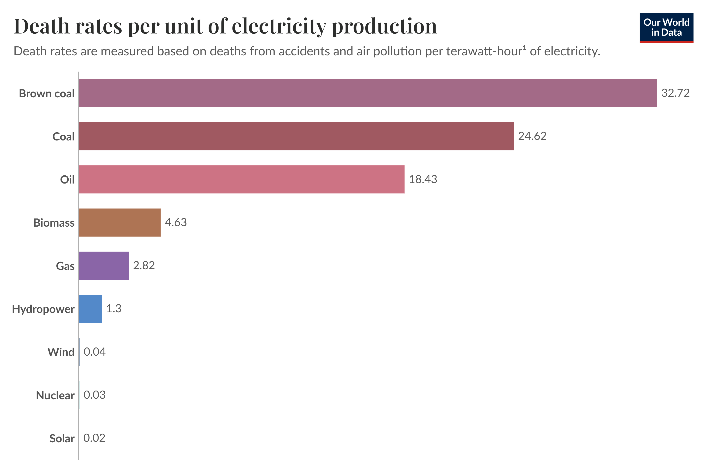
Is nuclear power safe?
Obviously, there isn’t a 1 in 12 chance of nuclear power stations exploding!
But how safe are they?
Our World in Data article on nuclear energy
Our Future Energy website for school learners
30 min video what happened to nuclear energy
5 min video on nuclear power (then 3 min pro and con videos)
How much power does
an AI server need?
Where can we get
the power from?
Where should we
put data centres?
Back to the questions
Notes:
Our Future Energy website created by Glasgow Science Centre
32min video is in depth, balanced and pretty accessible (although a little long!) if you want to find out more (and they use an OHP projector – remember them?! :-)
You could probably skip the first 6 min too and the last 2 min.

Slide 10


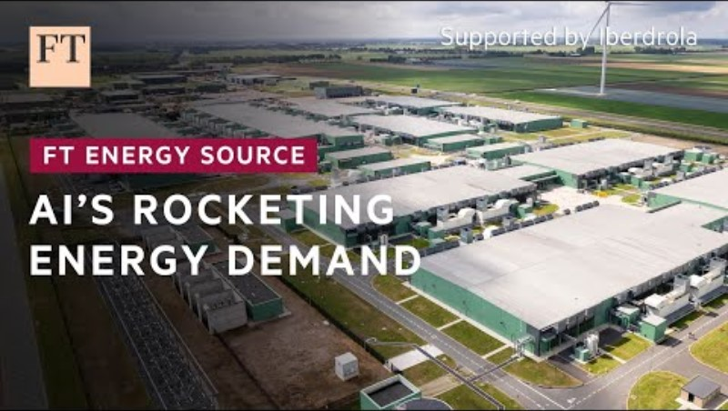

Where can we get the power from?
Can renewable sources of energy cope with the increased demand?
Should we use more nuclear power?
9 min Vox video on if clean energy can handle the AI boom
Our World in Data article on safety of energy sources
The Climate Game
3 min video AI’s energy demands
Is nuclear power safe?
How much power does
an AI server need?
Where should we
put data centres?
Back to the questions
Notes:
Financial Times Climate Game – can you reach net zero by 2050? https://ig.ft.com/climate-game

Slide 11

How much power does an AI server use?
Asking AI a question takes about ten times the energy than a normal Google search
We don’t know! The big companies do not publish their data.
We can try to work it out by studying how much energy different AI systems use.
Generating 1000 questions with AI used the same amount of energy as fully charging a smartphone
In 2023, generating 1000 images with AI used the same amount of carbon dioxide as driving 4 miles in a petrol car
‘Hugging Face’ AI Energy Scores
Nature article on AI energy consumption
2 min video on AI vs normal data centres
Is nuclear power safe?
Where can we get
the power from?
Where should we
put data centres?
Back to the questions
Notes:
https://www.technologyreview.com/2023/12/01/1084189/making-an-image-with-generative-ai-uses-as-much-energy-as-charging-your-phone/
Graph recreated using data from https://www.nature.com/articles/d41586-025-00616-z, but just displaying the mean energy not the spread, for readability.
There’s also an interesting graph on https://arxiv.org/pdf/2311.16863
This DOES NOT include the energy required to train an AI model. We don’t have data on this and can only make an educated guess. AI and tech companies (such as Microsoft, Google, Amazon) have not published this information so far.
Video is based on this ‘scrollytelling’ article from the New York Times https://www.nytimes.com/interactive/2025/03/16/technology/ai-data-centers.html
More info on https://savethe.ai/electricity/ including class posters https://savethe.ai/downloads/electricity_posters/SavetheAI-posters-electricity-EN.pdf

Slide 12

Where should we put data centres?
What do data centres need?
What do people and
communities need?
Article mapping data centres in hot climates
3 min video on issues of Irish data centres
Guardian article on data centres in England
14 min video on issues of where to put data centres and how to power them
Where can we get
the power from?
Do undersea data
centres exist?
Swimming pools heated
by servers? Really?!
Back to the questions
Notes:
You can see where Google’s data centres are on this map https://datacenters.google/locations/ and learn more about them.
Which countries have data centres: https://www.statista.com/statistics/1228433/data-centers-worldwide-by-country/

Slide 13



Swimming pools heated by servers??
Yes! Octopus Energy have been trialing server cooling equipment that heats up the water in swimming pools in the UK.
See servers heating UK pools (3 min)
BBC Click: servers heating Dmanish homes (4 min)
BBC article on heating pools
Paris data centres heating the Olympic pool and growing fruit! (10 min)
Do undersea data
centres exist?
Do AI servers really
need that much water?
Why can’t we use
sea water?
Back to the questions

Slide 14

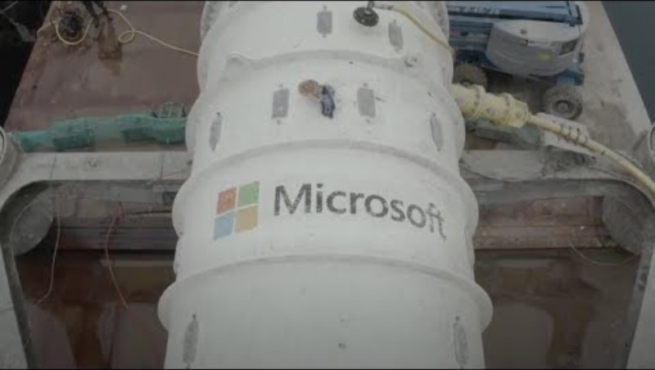
Do undersea data centres exist?
Yes! Undersea data centres have been trialled by Microsoft in Orkney in Scotland. They say it was a success, but it hasn’t been used by other companies.
Why do you think there’s not more companies using undersea data centres?
Microsoft
report on Project Natick
Find out about Microsoft’s undersea data centre trial (2 min)
Swimming pools heated
by servers? Really?!
Do AI servers really need that much water?
Why can’t we use
sea water?
Back to the questions
Notes:
Possible answers: Perhaps it’s too expensive, can’t be scaled up easily, or there are too many risks with putting the servers in the sea?

Slide 15


Why can’t we use sea water?
The salt and minerals in sea water are corrosive, so it is difficult to work with.
The water also needs to be cold enough to cool the servers!
There are data centres in Finland and Sweden cooled by sea water.
They also have to watch out for jellyfish getting sucked in with the water! (source)
14 min video on why servers need pure water
Using canals for Google data centres (5 min)
A report from Google said that 78% of the water used in their data centres worldwide is ‘potable’ (drinking water). (source)
Water is also needed for making the semiconductors in AI systems. An average chip factory can use as much water as 33,000 households every day. This water must be ‘ultrapure’, not salty sea water.
1 min video on what is a semiconductor
Swimming pools heated by servers? Really?!
Do undersea data centres exist?
Do AI servers really need that much water?
Back to the questions

Slide 16
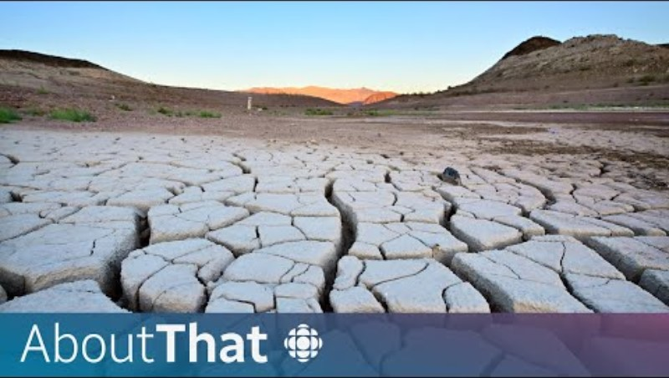

Do AI servers really need that much water?
Do AI servers really need that much water?
Where does the water come from?
Posters by savethe.AI
Video exploring water usage in tech and in our lives (14 min)
Swimming pools heated
by servers? Really?!
Do undersea data centres exist?
Why can’t we use sea water?
Back to the questions

Slide 17

Is Atlantis real?
Unfortunately, Atlantis is a myth!
(as is Wakanda too)
Why are these myths useful in our society?
3 min video on the mythical lost city of Atlantis
Where does the
data come from?
Do we need to use
so much data?
Should we use AI?
Back to the questions

