Slide 1
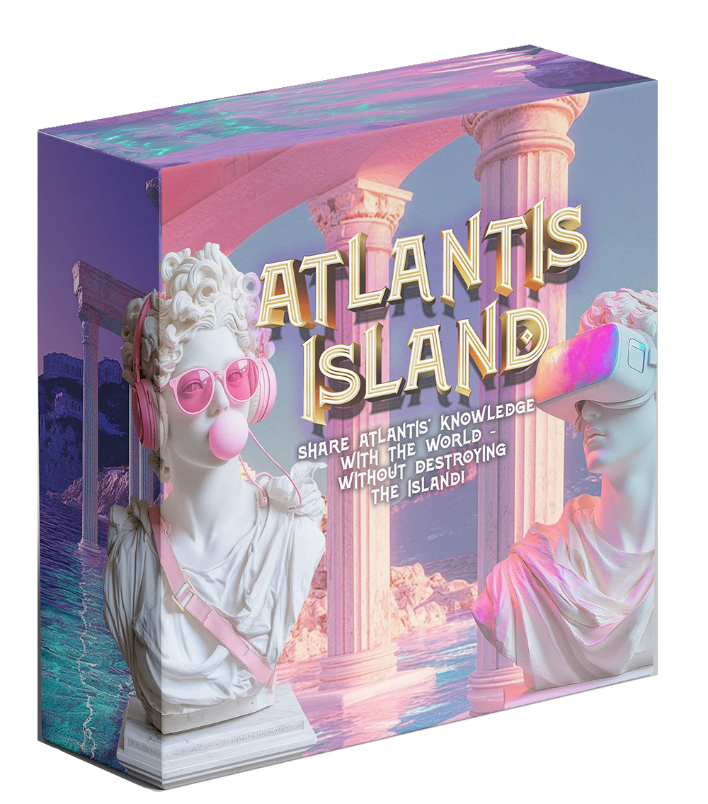
How to play
Atlantis Island

Slide 2
Atlantis Island
Atlantis Island, long thought to be lost to the oceans,
has actually been safe but hidden all these centuries.
The Atlanteans have decided to reveal their presence to the rest of the world and share their knowledge in the hope that it might benefit humankind and the planet.
You have been invited to the island to set up a web server business, digitising the libraries, galleries, theatres, news and marketplaces of Atlantis.
Work together to upload and share as much data as you can… without damaging the island.

Slide 3




Digitising knowledge
There have been projects before to digitise culture and knowledge.
Google Arts and Culture had 32,000 images of artworks after just one year of the project.
Project Gutenberg is a free library of 79,000 ebooks.
Wikipedia is a free encyclopaedia with over 7 million articles.
The National Library of Scotland has 3,000 films and video clips from over 100 years.

Slide 4



Atlantis Island
Data Centres that run web servers and AI services need three main things:
Data: huge amounts of data are needed to train AI systems, but websites need data too.
Power: electricity is needed to run the servers. Data centres need lots of power!
Water: Servers get very hot. Water cooling is more effective than air cooling

Slide 5
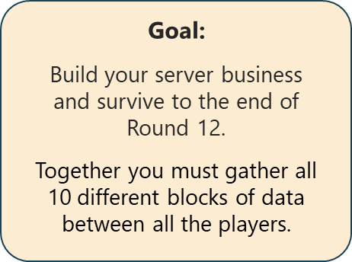
Aim of the game
Develop a tech business to digitise and share all the knowledge of Atlantis.
Go from simple websites to
social media to AI services
…but don’t let Atlantis fall!
Notes:
The aim of the board game is for all players to set up and run their own tech business to digitise and share all the knowledge of Atlantis, go from simple websites to social media to AI services and to get to the end of 12 rounds without destroying Atlantis Island or its inhabitants.

Slide 6
How to win?
There is no winner of the game –
all players win if the island survives and all the island’s knowledge is digitised and shared.
All players lose if Atlantis falls!
Notes:
Atlantis Island has survived thanks to the islanders’ careful balance and harmony with nature. Try not to use too much water, so there is always enough drinking water. Try not to use too much power, so there is always enough to power the hospital and homes, and keep the sea barriers machinery working otherwise Atlantis would sink. Try to not pollute the air by using too much fossil fuel too, so that the islanders can breathe clean air.

Slide 7


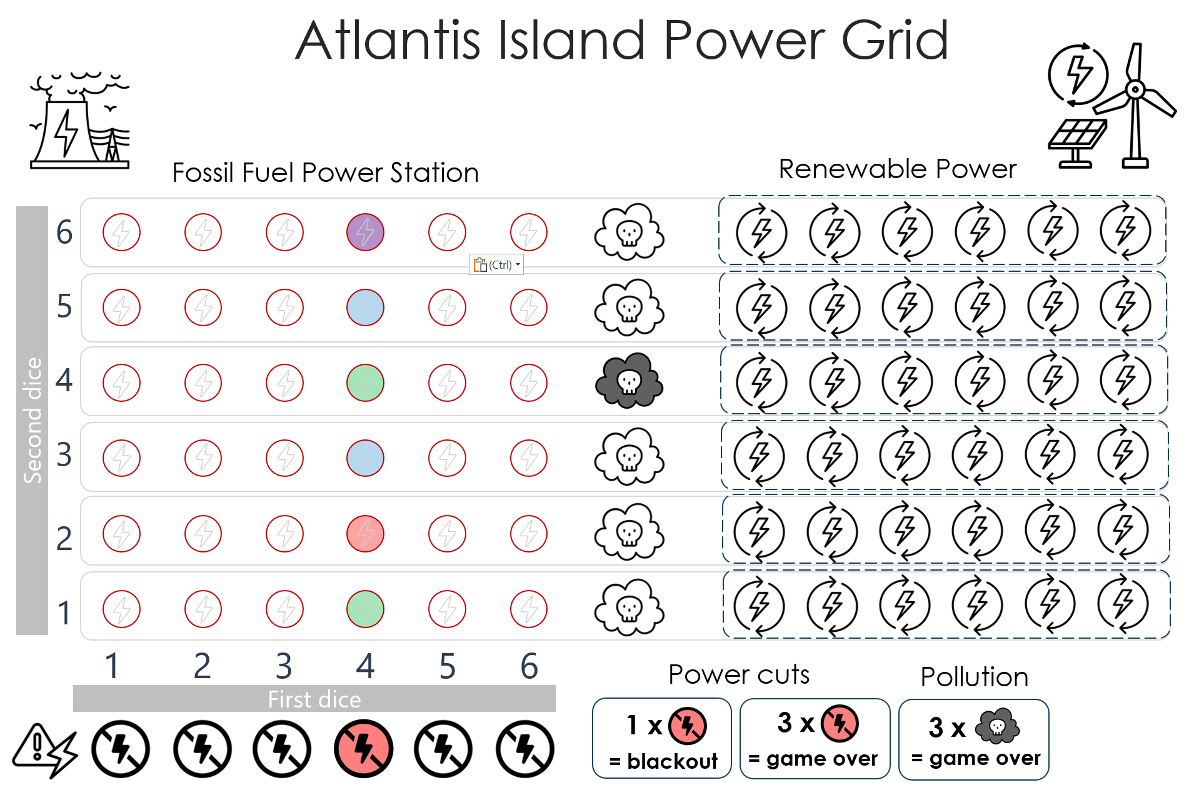
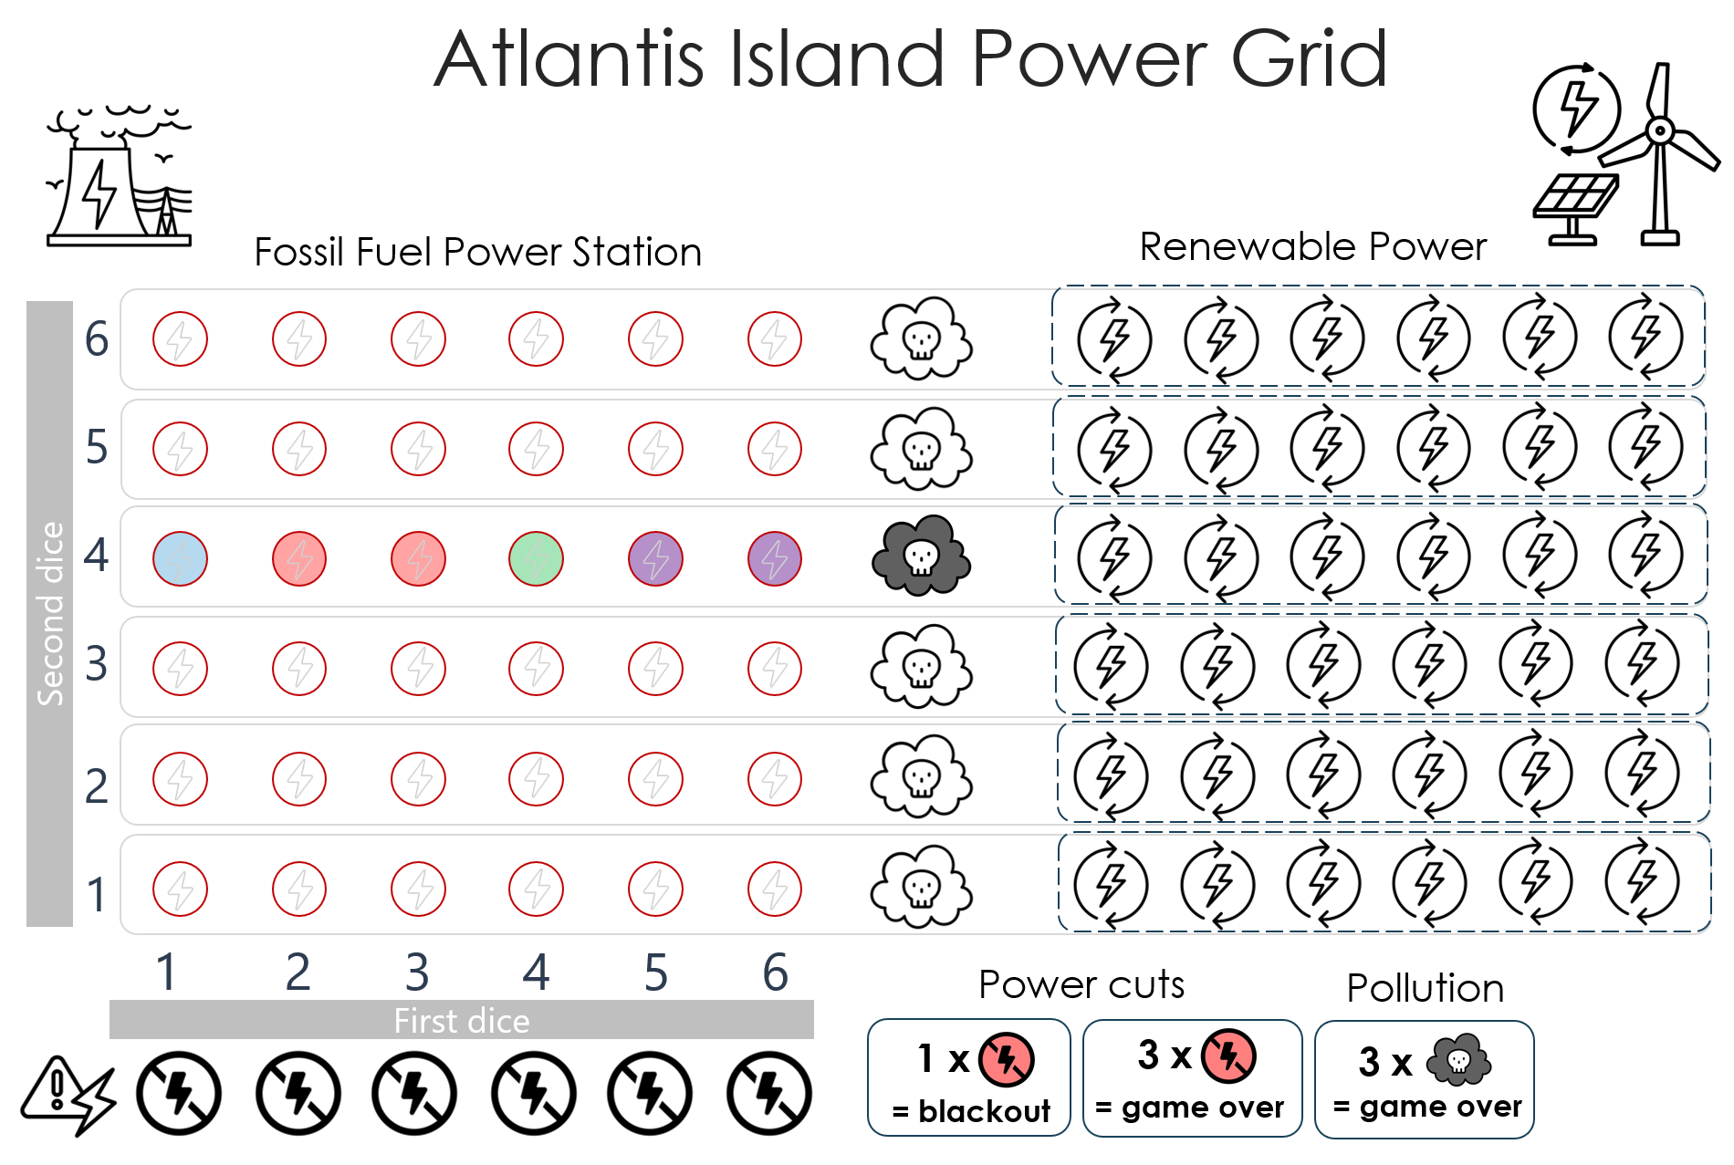
Protect the Island
Try not to use too much water
Try not to use too much power
Try to not cause air pollution with fossil fuels
Notes:
Atlantis Island has survived thanks to the islanders’ careful balance and harmony with nature. Try not to use too much water, so there is always enough drinking water. Try not to use too much power, so there is always enough to power the hospital and homes, and keep the sea barriers machinery working otherwise Atlantis would sink. Try to not pollute the air by using too much fossil fuel too, so that the islanders can breathe clean air.

Slide 8
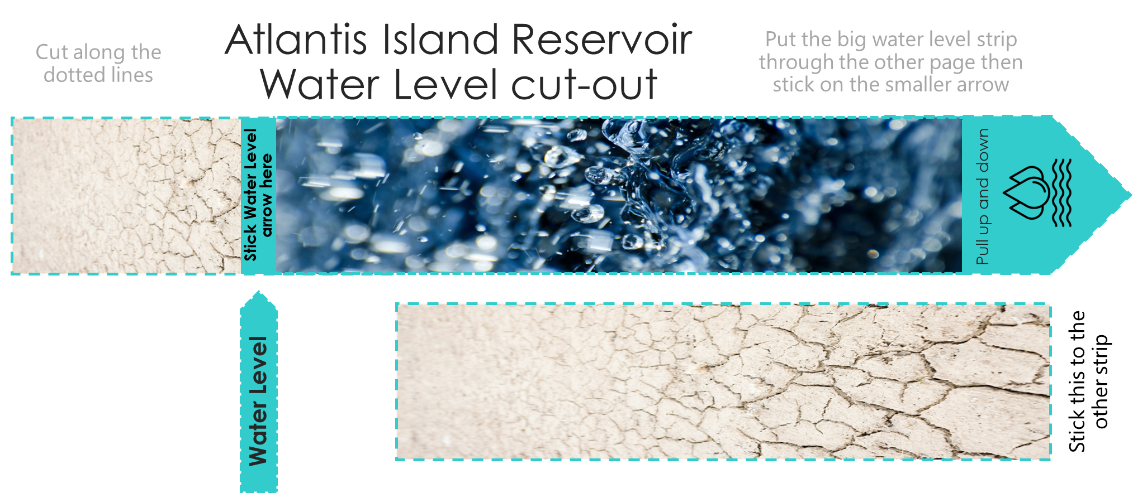

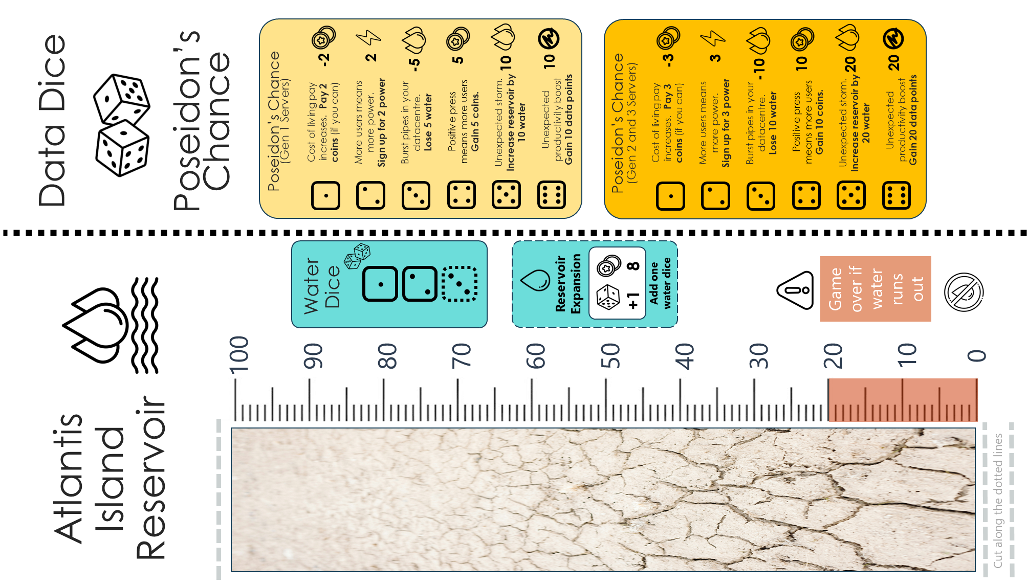
Setup: set out the game
Assemble the reservoir water level
Cut out and stick the pieces together.
Cut the dotted lines on the reservoir.
Slide the level through the cut holes.

Slide 9

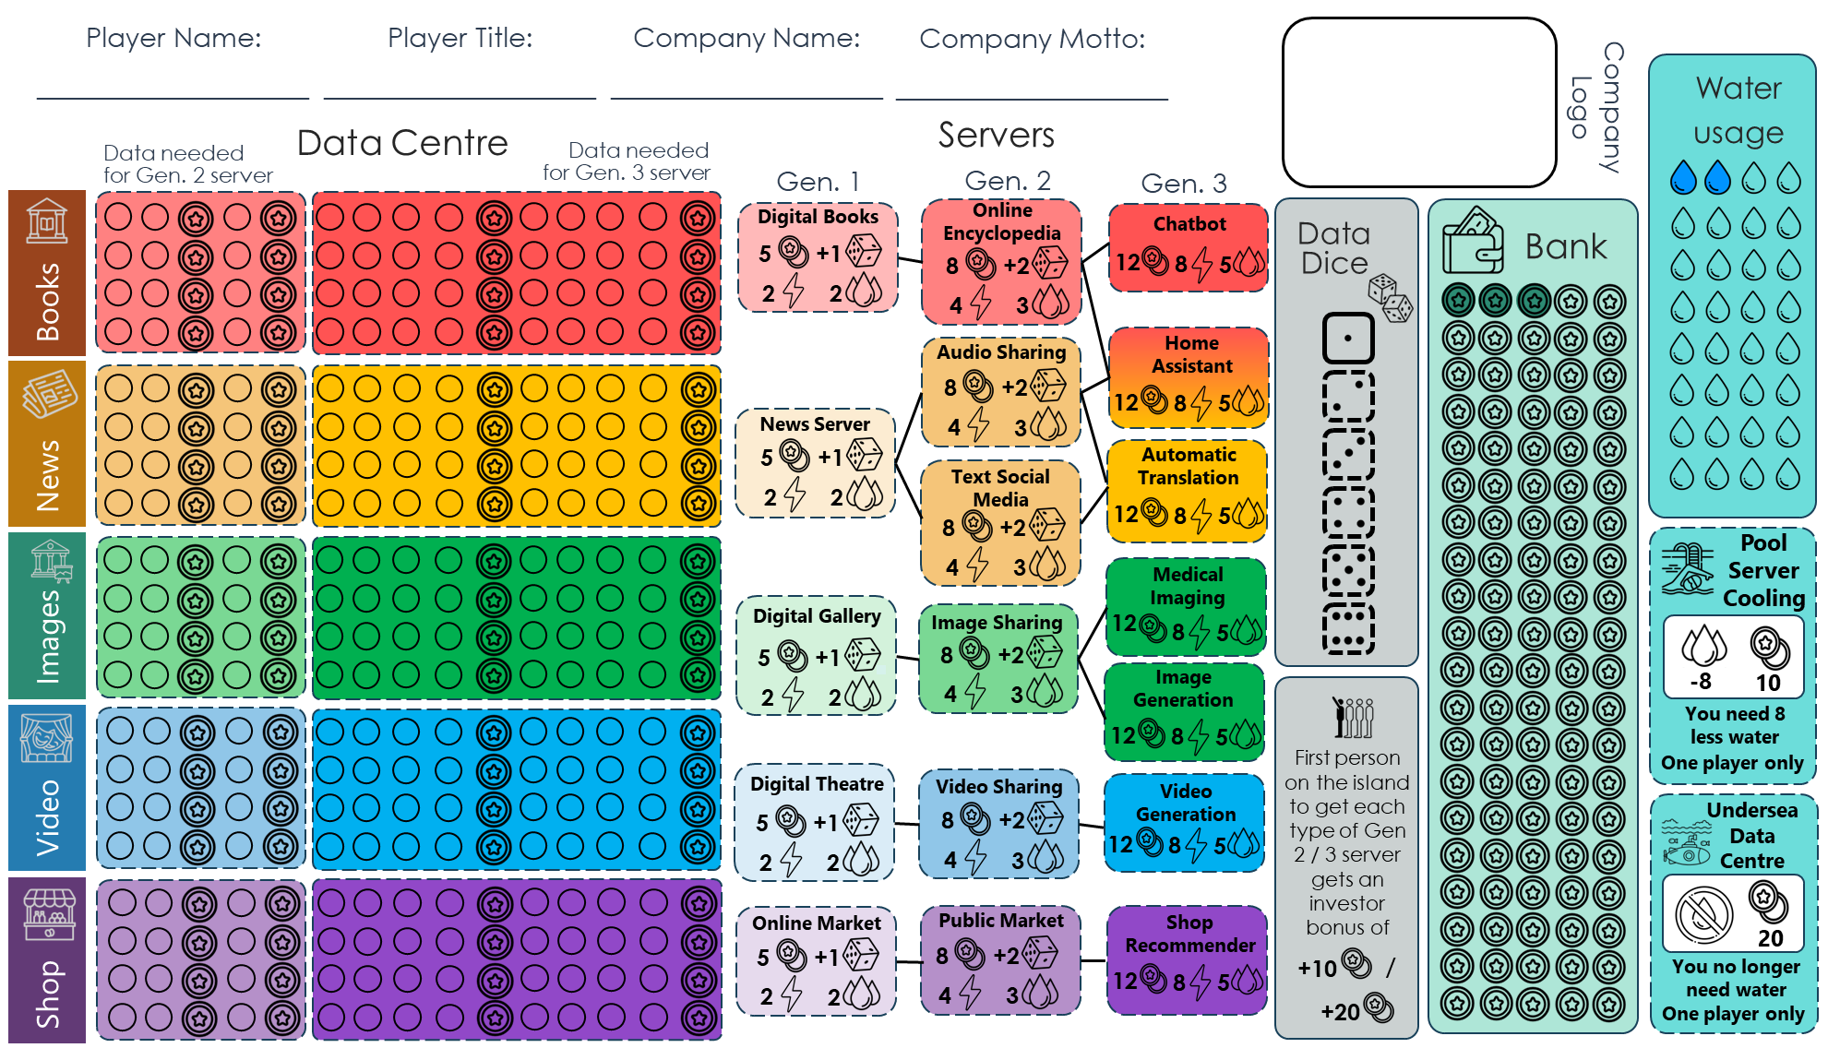

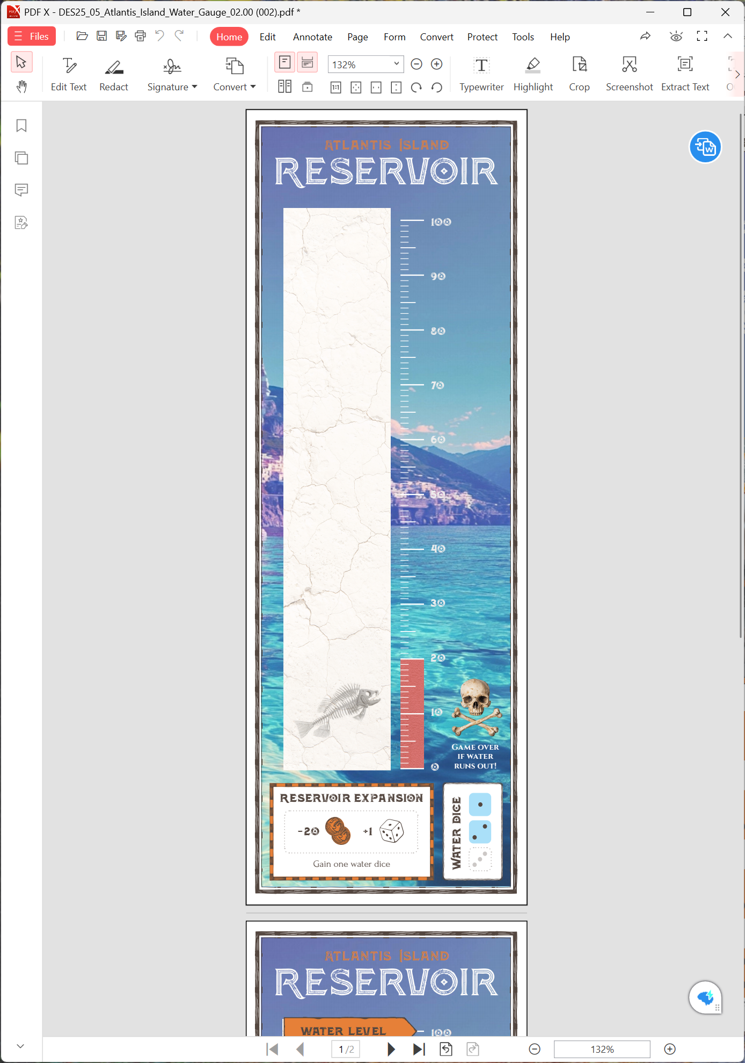
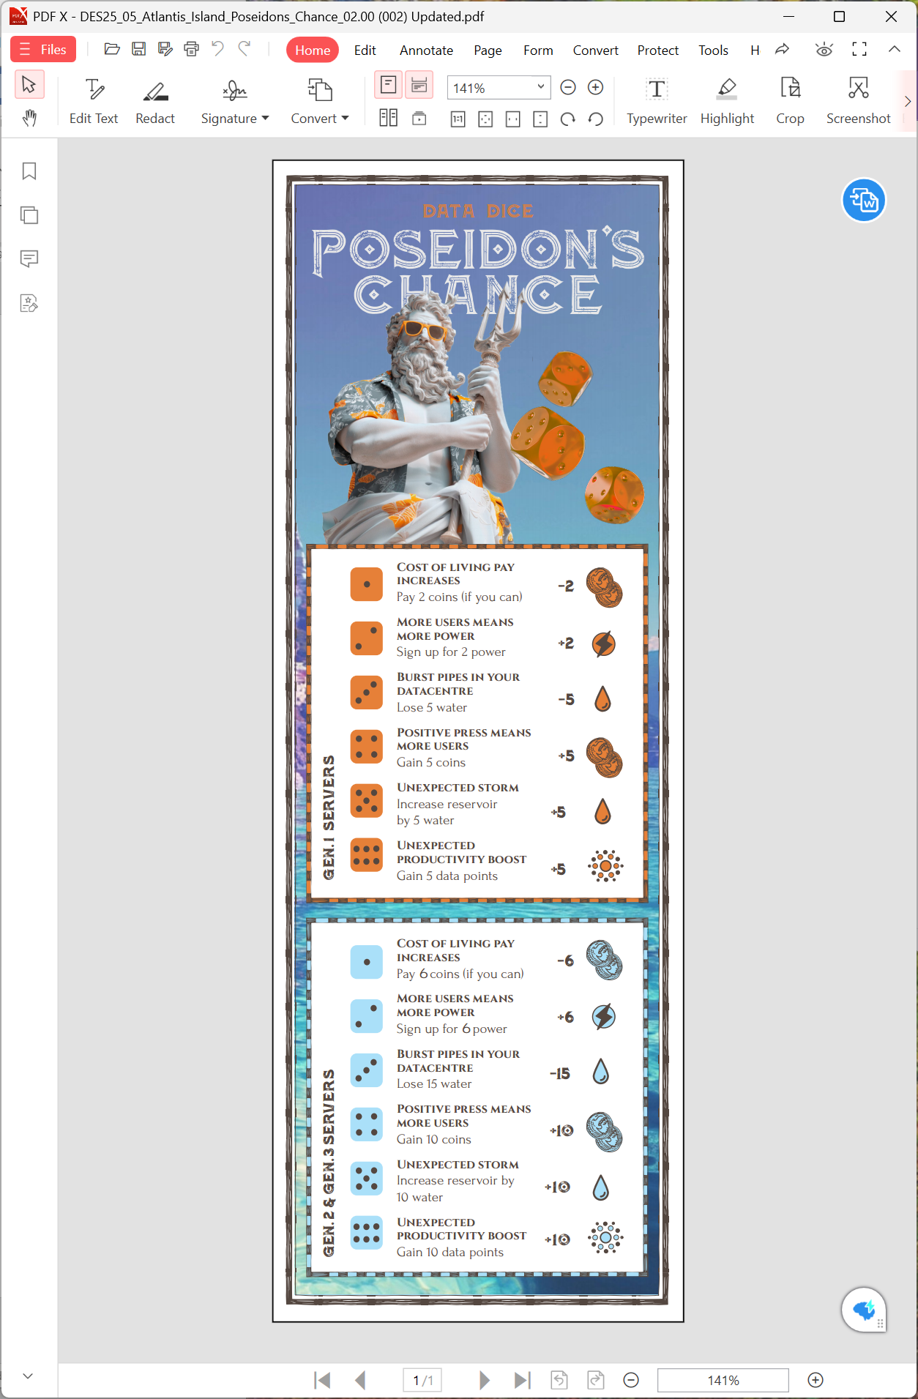
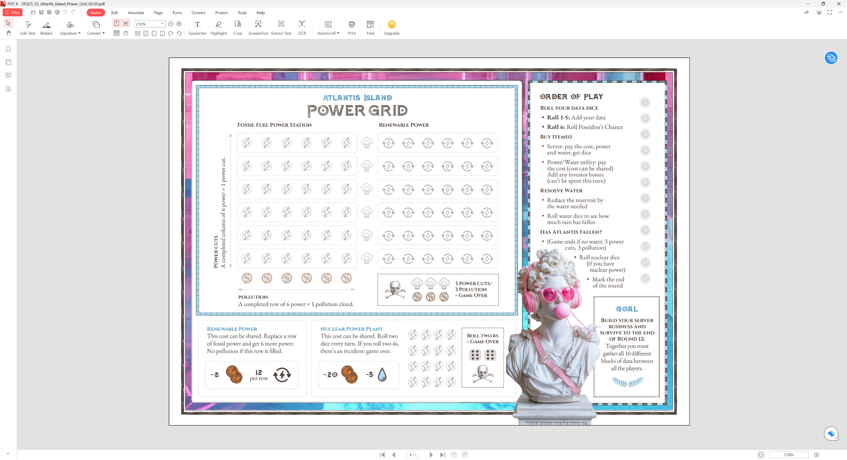
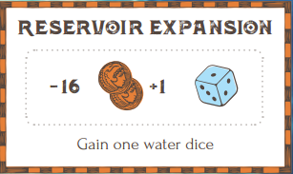




Setup: set out the game
This is a game for four players (or pairs)
Each player gets a board with their data centre, servers and bank.
Put the island power grid in the middle, with the reservoir water level and the Chance tables.
You will need four pens, preferably a different colour for each player.
You will also need a bunch of six sided dice (D6s) or you can use a dice app or website like flipsimu.com/dice-roller

Slide 10
Setup: set out the game
Notes:
This is a game for four players (or pairs)
Each player gets a board with their data centre, servers and bank.
Put the island power grid in the middle, with the reservoir water level and the Chance tables.
You will need four pens, preferably a different colour for each player.
You will also need a bunch of six sided dice (D6s) or you can use a dice app or website like flipsimu.com/dice-roller

Slide 11
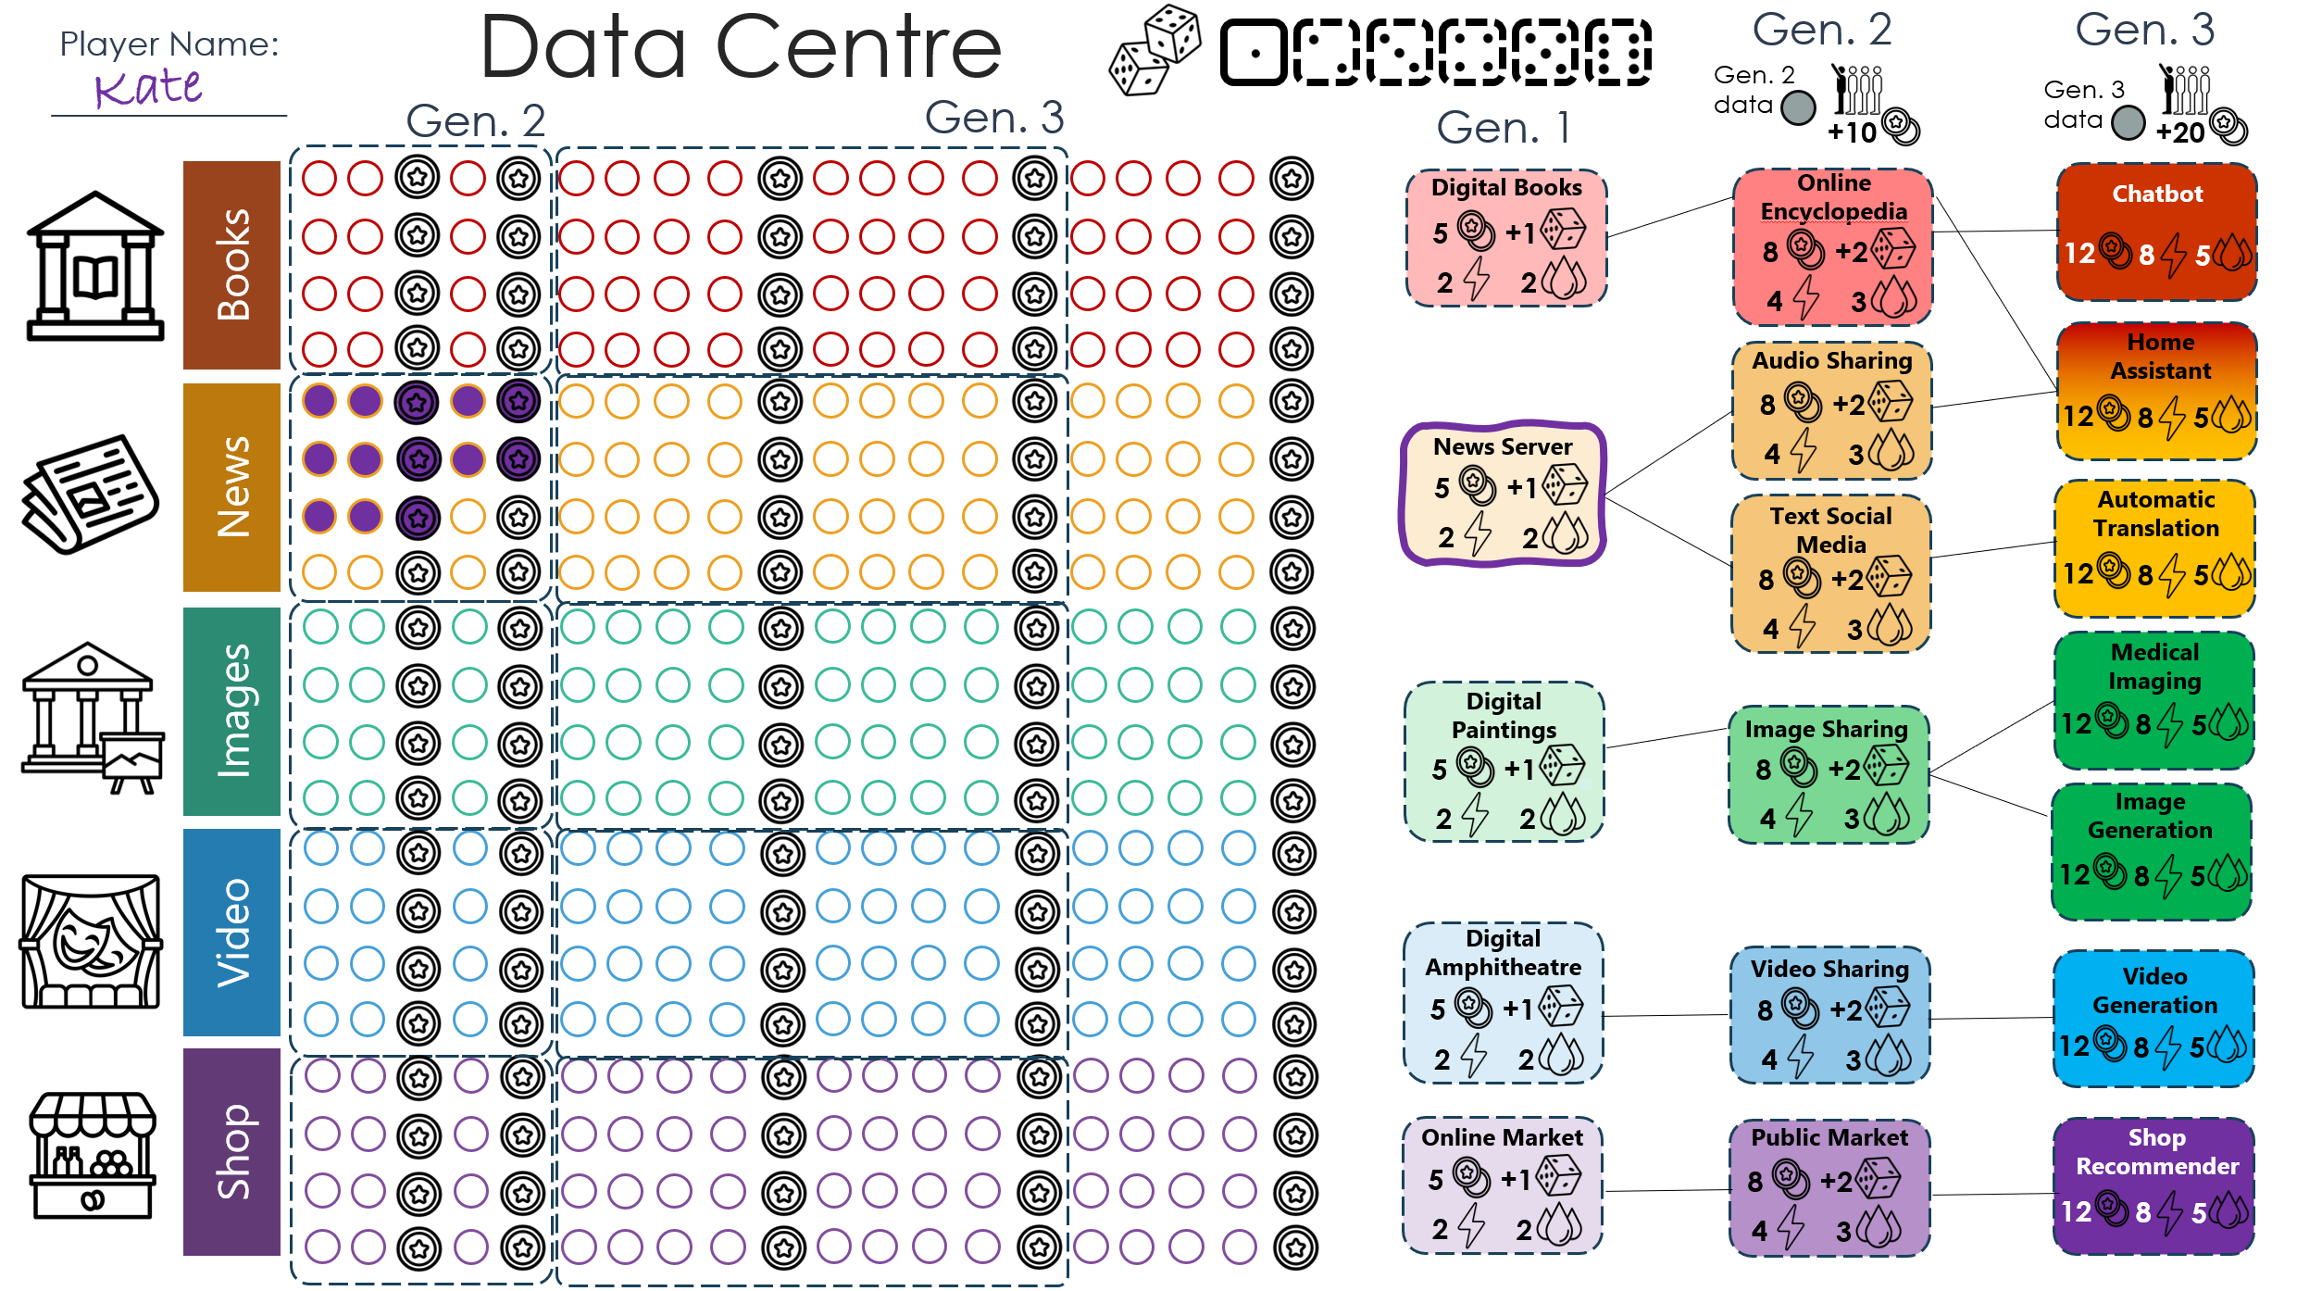
Setup: Choose your first server
Draw a line around your server
to show it’s been bought
It doesn’t matter which one you choose, but you might want to be different from other players
Notes:
At the start of the game you will choose a Gen1 web server. You can choose to focus initially on digitising books, images, videos, news or shop items. You will gather data and earn money as more people access your data and servers.
You can then save up for additional servers, including Gen2 (which are social media style) servers, and finally Gen 3 (or AI) servers. Getting more Gen 1 and 2 servers give you more dice to roll (so you can gather more data).

Slide 12

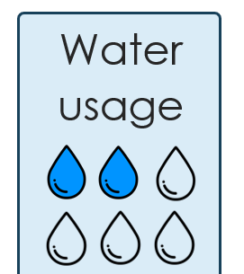

Setup: Choose your first server
0
Your first server is free!
The water for this server has already been added
The server gives you one ‘data dice’
Notes:
Choose a Gen 1 server and draw a line around it.
The first server is free, so you don’t need to pay 5 coins.
Your water usage has already been filled in.
The server gives you one dice that you’ll be able to roll each round.

Slide 13
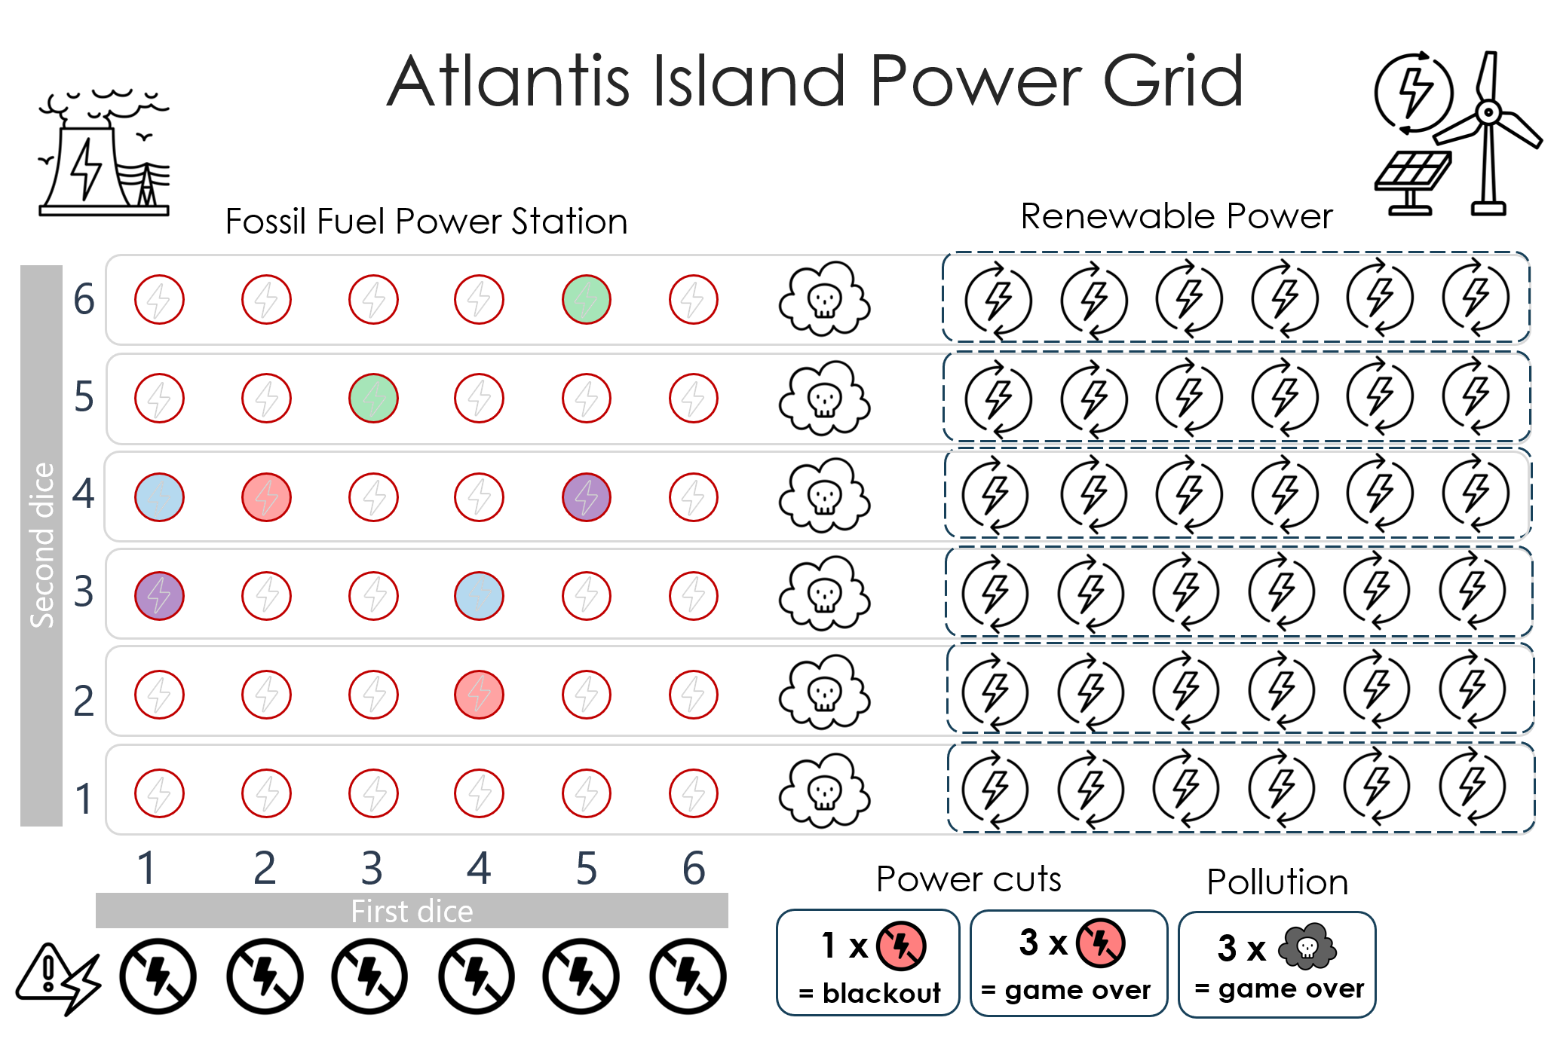
Setup: Power your server
Write your initials or colour in two power circles on the Island power grid
If you use colours, every
player needs a different colour
Notes:
You will need to sign up for two power for your server. On the island power grid, put your initial in any two of the circles (or with your colour, if all the players are using different coloured pens.)

Slide 14
Playing the game
The ‘Turn Order’ list helps you keep track of the game
Everyone plays the round at the same time
…but you can take it in turns if you prefer!

Slide 15
Playing the game
You start with one ‘data dice’
You can get more ‘data dice’ by buying more servers
Notes:
Players roll dice each round to find out how much data they have managed to digitise.
At the start of the game, this will be one die, but as you buy servers, you gain more dice to use.

Slide 16
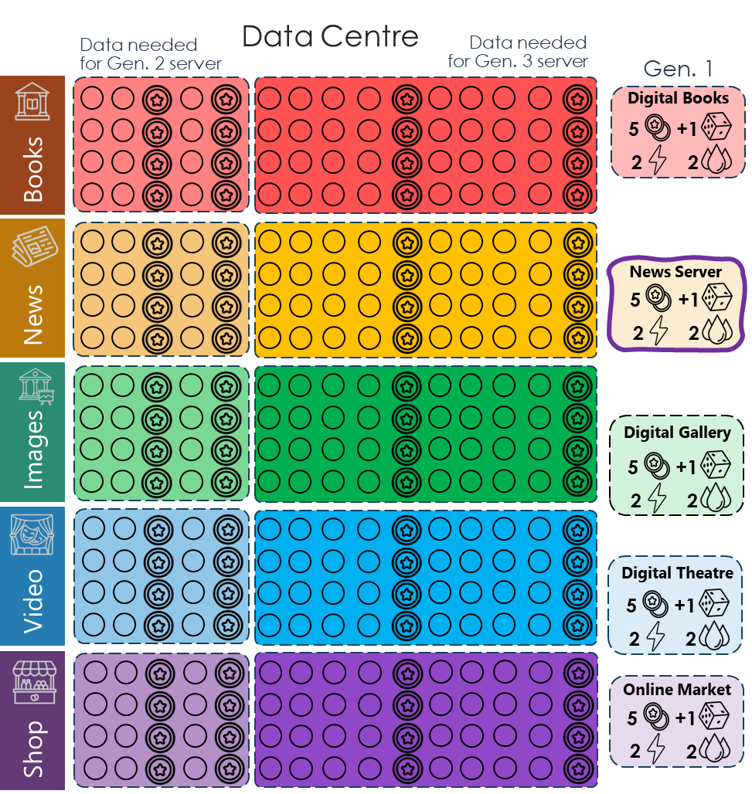
Gathering data
and earning money
You will be rolling your dice and adding the data to your ‘Data Centre’
If you roll a 1, 2, 3, 4 or 5, fill in that many data points
Notes:
If you roll 1-5 then fill in1-5 circles in your data repository. You can choose to fill in circles of any data type (books, images, video etc.) although you might want to focus on gaining data in the same row as your Gen 1 server(s) to be able to expand later.

Slide 17
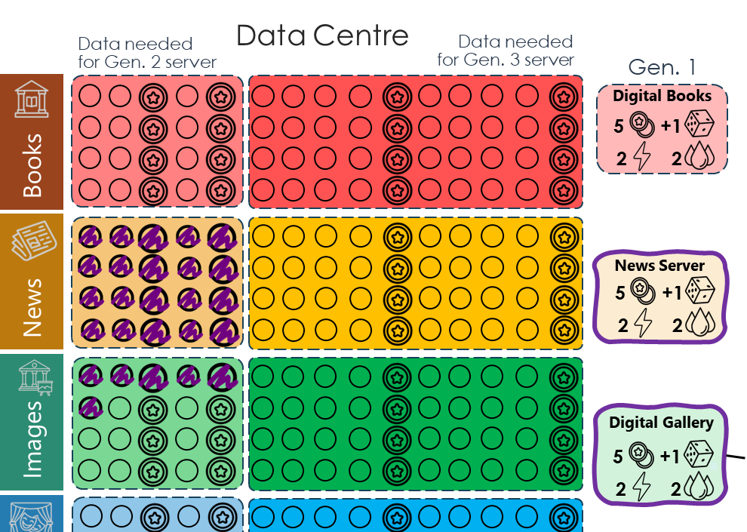
Gathering data
You can gather data of any type, but it’s more useful when you have a server using that type of data.
Notes:
Normally you will gather data related to your business, for example gathering green images data if you have a ‘Digital Paintings’ business or red books data if you have a ‘Digital Books’ business. You can choose to split your dice roll between different data types. For example, if you roll a 4, you could fill in 2 books data circles and 2 images data circles.

Slide 18
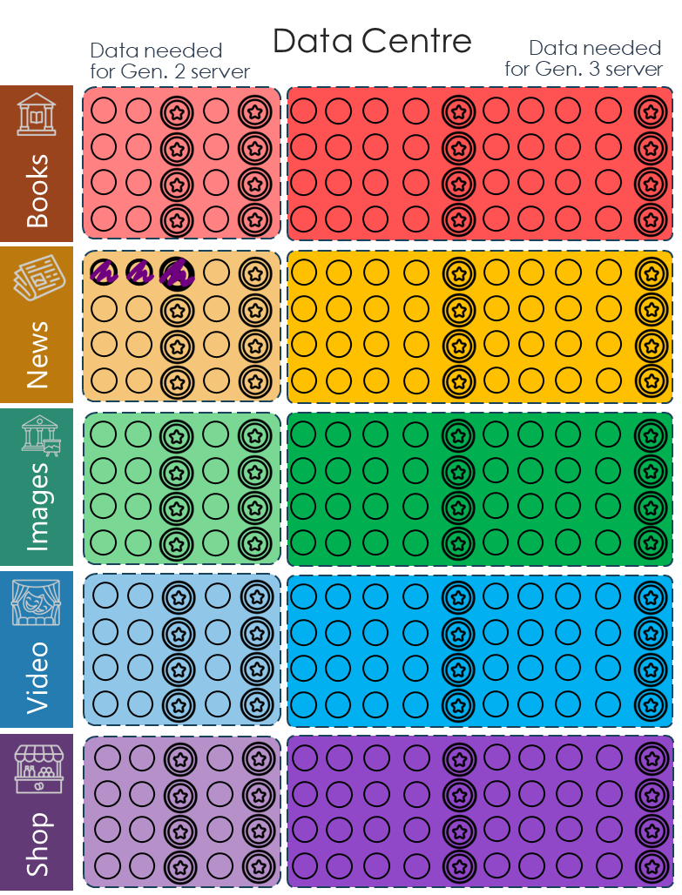

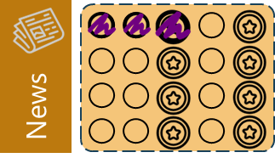
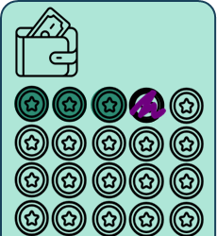
Gathering data and earning money
If you roll a 3 in the first turn, fill in 3 data points
Bank
If you colour in stars, add that many stars to your bank
Notes:
If you fill in one of the starry circles, you have earned one coin. Colour in one starry coin in your bank for every coin you earn in your data centre.

Slide 19
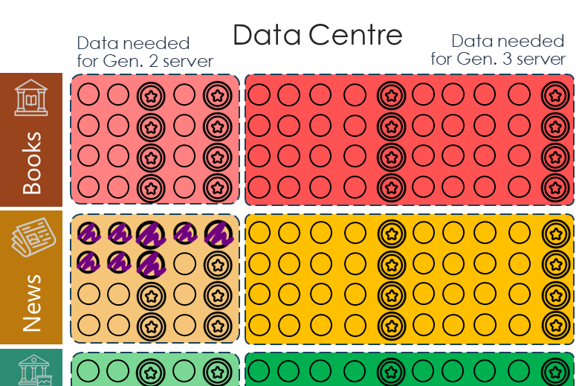

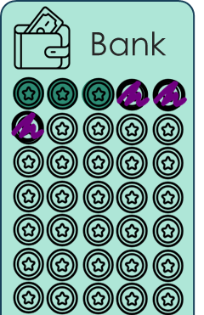
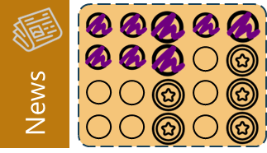
Gathering data and earning money
If you roll a 5 in the next turn, fill in 5 more data points
If you colour in stars, add that many stars to your bank

Slide 20
Rolling a six
If you roll a six, you don’t get data.
Roll that dice again and check the Poseidon’s Choice table to find out what happens!
If you run out of money (or water or power) just do what you can. For example, if you need to pay 2 coins but you only have one, just pay one coin.
Notes:
If you roll a six on any of your dice, this will cause an event to happen. Roll each of these dice again and check the Chance chart to see what happens. Resolve the effects immediately, adding or subtracting power, money, water or data from the appropriate place.

Slide 21
Rolling a six
Once you buy your first
Gen. 2 server, use the
Gen 2 and 3 table if you roll a six.
Some things are worse, but some are better!
Notes:
At the start of the game, use the Gen 1 server Chance table if you roll a 6. Once you buy your first Gen. 2 server, switch to the Gen 2 and 3 table if you roll a six. Some things are worse, but some are better!

Slide 22
Buy item(s)
You won’t have enough money on your first turn to buy anything yet.
Keep saving!
Notes:
If you have enough money to buy something (a server, power or water utility) then you can do this at this point of the round. You won’t have enough money in the first round though!

Slide 23
Resolve water
We need to check how much water we’ve used to cool our servers
Notes:
Each round you will need to reduce the water level depending on the water requirements of your servers.

Slide 24
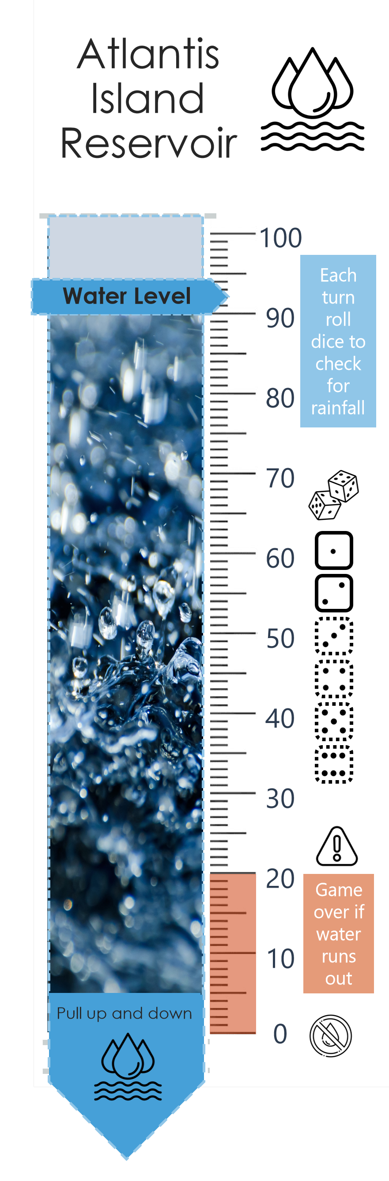
Resolve water
Count up how much water every player needs
Move the water level down that many drops
(This will be 8 for four players at the start of the game)
Notes:
Each round you will need to reduce the water level depending on the water requirements of your servers. For example, if you have one Gen1 server, reduce the water level by the two water drops shown on that server. In the first round, the four players will need to reduce the reservoir by 8 water drops.
Each round count up how much water all your servers need. Pull the reservoir water level down by that many water drops.

Slide 25
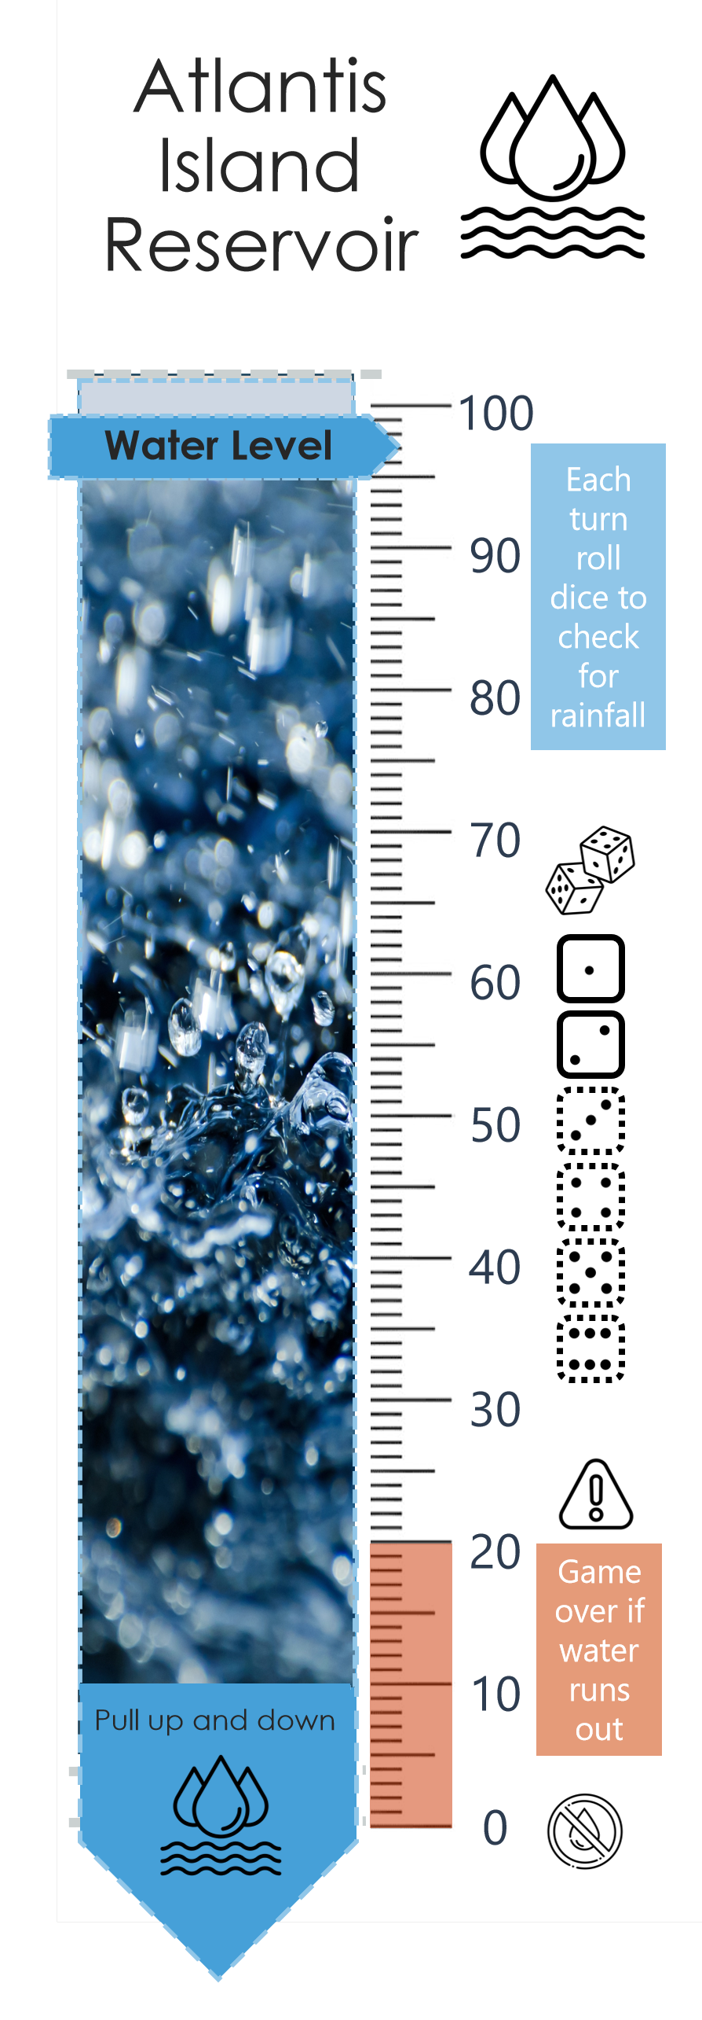


Roll for rainfall
One player should roll two ‘water dice’ to find out how much rain has fallen on the island this round.
Move the water level
up that many drops
Notes:
Each round, one player should roll two dice to find out how much rain has fallen and filled up the island’s reservoir. Move the water level up by that number. For example, if the dice rolled were a 6 and a 4, move the water level up by ten.

Slide 26
Has Atlantis fallen?
You won’t have done enough to damage the island yet.
Be careful though!
Notes:
Check to see if there is still power and water. If the water level is at zero or there are no free power spots then the islanders die. If there are three pollution clouds filled in, then the islanders die.
If a player has purchased the nuclear power plant, they should roll two dice. If two 6s are rolled, then the nuclear power plant has an accident and the islanders die.

Slide 27
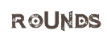
End of the round
Cross off Round 1
Well done!
Now go back to the start of the Turn Order list
Notes:
Score off the round number. This helps you to keep track of how far you are through the game.

Slide 28
Buying a server
You can buy a server during the ‘Buy items’ phase of each turn.
Notes:
Once you’ve saved enough, you can choose to buy additional servers or power/water utilities.

Slide 29
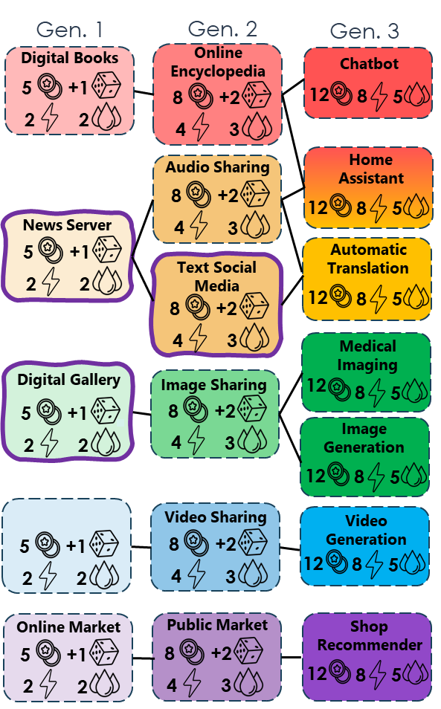
Buying a server
Once you have enough money saved up, you can buy more servers and expand your business.
Notes:
You need enough money to buy a Gen 1 server.
You also need enough data to buy a Gen 2 or 3 server!

Slide 30
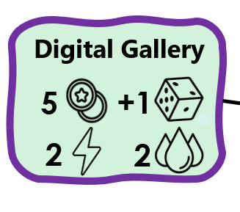
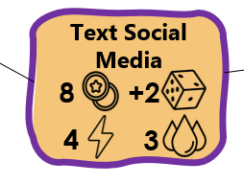
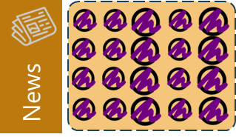
Buying a server
If you have 5 coins you can buy another Gen. 1 server
Or you up get a Gen. 2 server if you have 8 coins and have filled the Gen 2 data box of the right colour.
Notes:
You need enough money to buy a server.
You need enough data to buy a Gen 2 or 3 server!

Slide 31
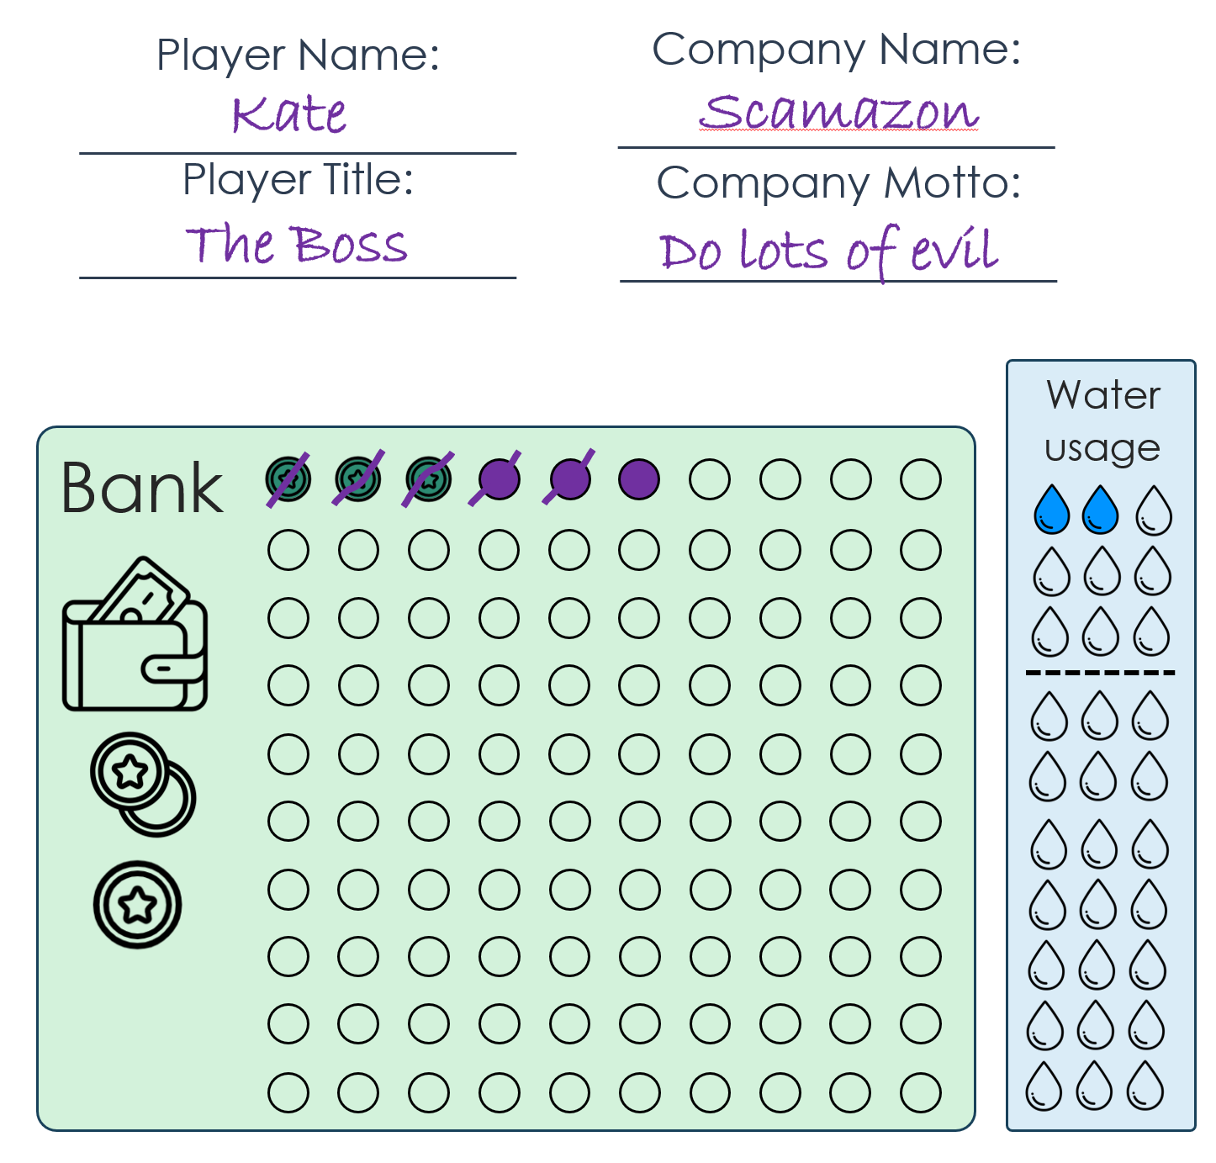
Buying a server
Pay for your server. Score off the correct number of coins in your bank.
Notes:
You pay the cost for your purchase by scoring off the coins in your bank/wallet. Fill in the appropriate dotted line to show you now own that item.

Slide 32
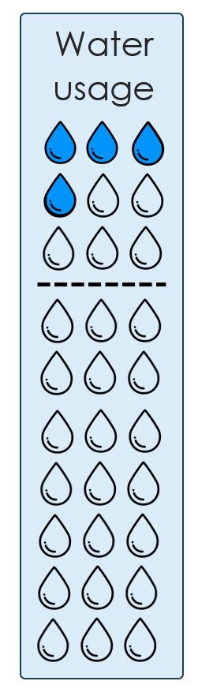
Buying a server
Update your water usage. Colour in the correct number of water drops.
Notes:
Fill in the appropriate number of water spots on your board.

Slide 33

Buying a server
Update your data dice.
Colour in the correct number of dice on your board.
Notes:
If your purchase gives you 1 or 2 extra dice, fill in the dotted line for your new dice.

Slide 34
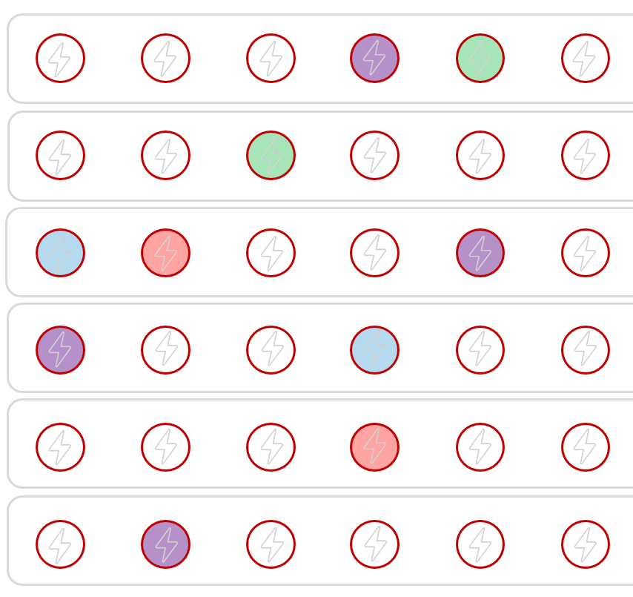
Buying a server
Sign up for more power.
Colour in the correct number of power circles on the island’s Power Grid.
Notes:
Sign up for the appropriate number of power spots.

Slide 35
Try the game!
Try a few rounds of the game and come back after round 3 or 4.

Slide 36
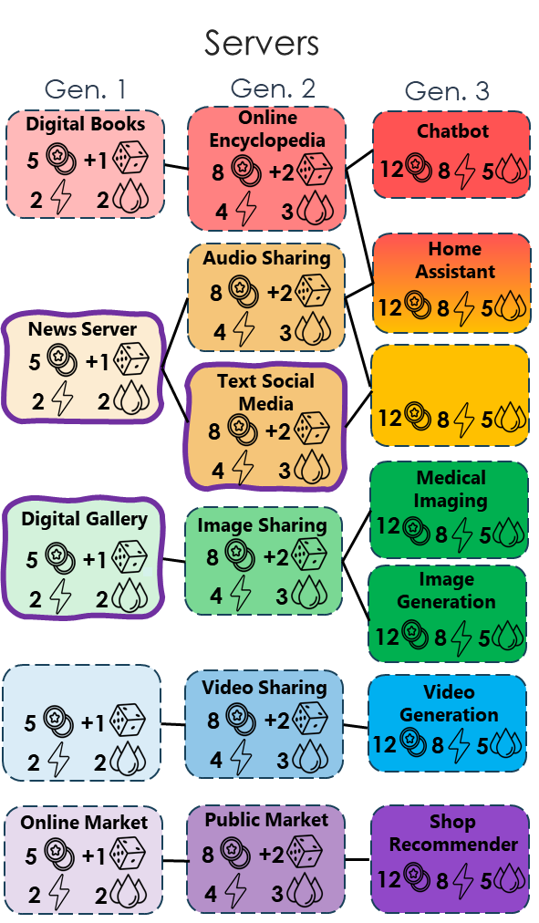
Buying Gen 2 and 3 Servers
You must have the previous type of server before getting a more advanced server.
Follow the lines to see which servers you can buy
Notes:
You must have the previous type of server before getting a more advanced server. For example, you must have a yellow Gen 1 News Server before you can progress onto a Gen 2 Text Social Media server.

Slide 37
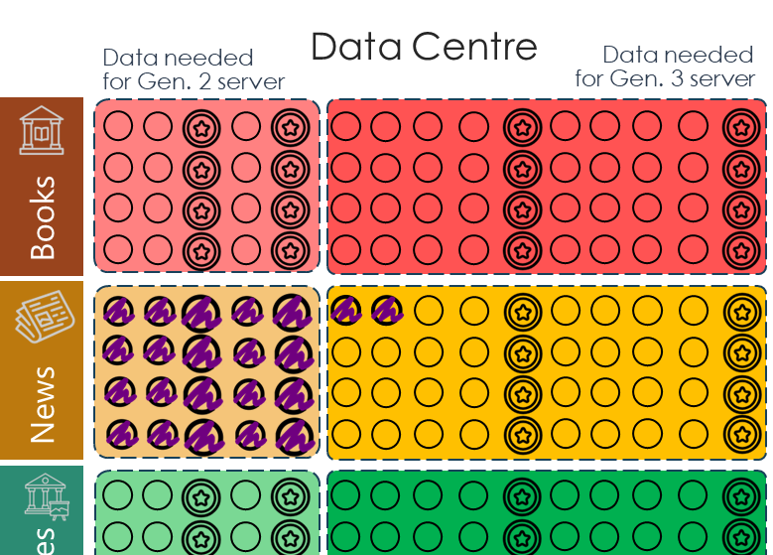

Buying Gen 2 and 3 Servers
You must have enough data of the right type to buy a Gen. 2 or a Gen. 3 server.
Make sure the correct box is filled with coloured in data points in your data centre.
Notes:
You must have enough data to buy a Gen 2 or 3 server. Make sure the correct Gen 2 box is filled with coloured in data points in your data centre to buy a Gen 2 server (or the Gen 3 boxes to then buy a Gen 3 server).

Slide 38
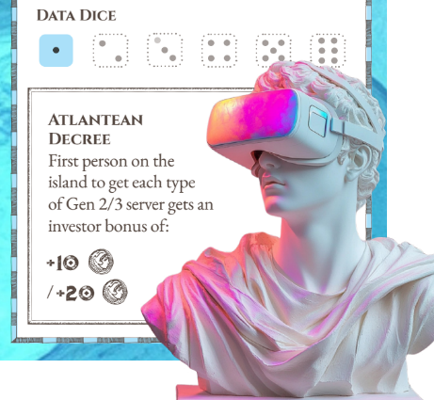
Gen 2 and 3 Servers: Investor bonus
The first person to buy each type of Gen. 2 and Gen . 3 server gets an investor bonus.
You must have enough data of that type to buy the server.
Add the coins:
5 coins for Gen 2
10 coins for Gen 3
(You can’t spend the money straight away!)
Notes:
There is an ‘Investor Bonus’ available for the first player to buy each type of Gen 2 and 3 server. For example, the first person to buy an image sharing server will get 10 coins. If you are the first player to buy a server with an investor bonus, you can add those coins into your bank, but you cannot spend them this round.

Slide 39
Power, Pollution and Renewable Energy
As well as servers, you can buy power and water utilities, that will help you to not run out of power or water when you’re running your business.
Renewable power sources will help not cause air pollution, to keep Atlantis Island a nice place to live for the islanders.

Slide 40
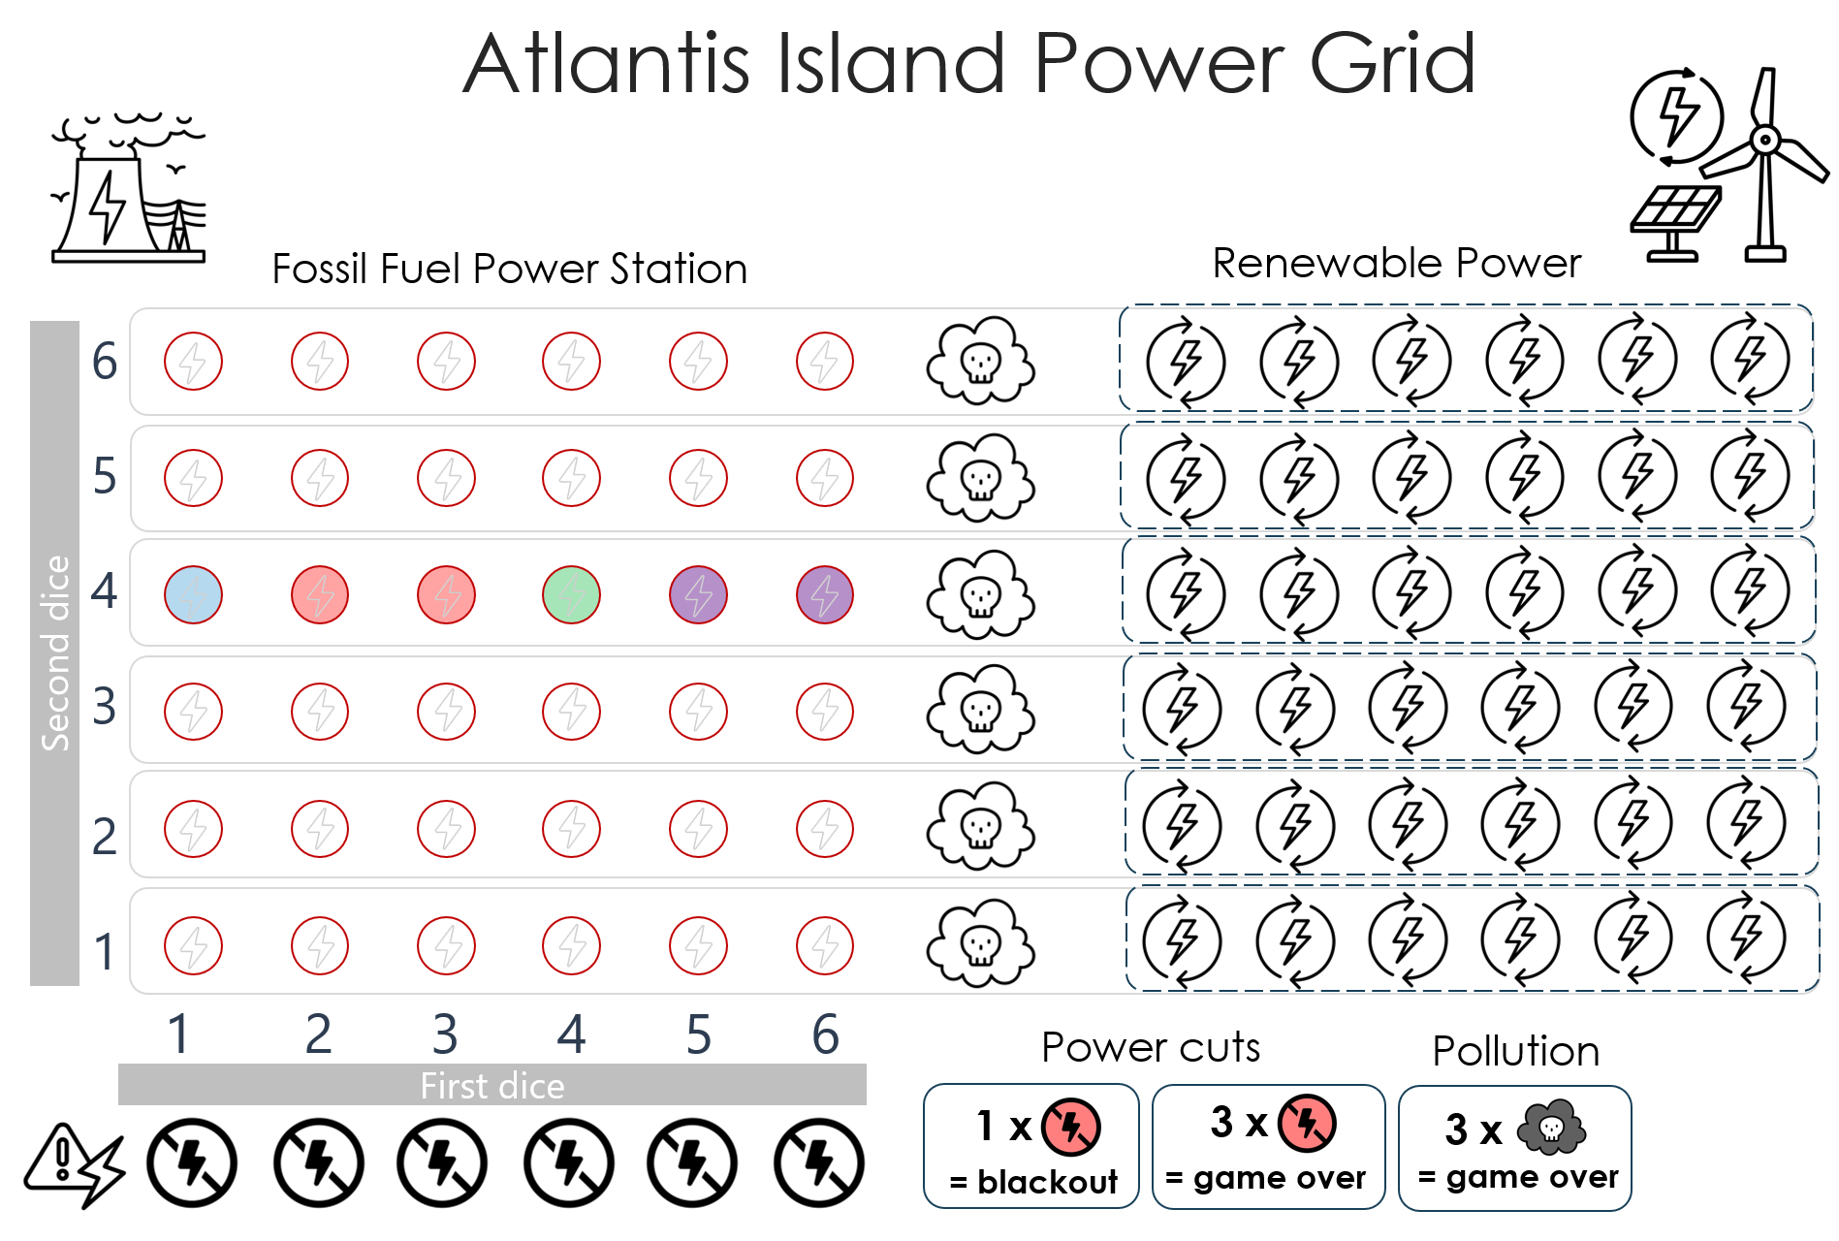
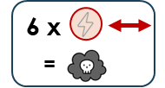
Pollution
If you colour in all the power circles in a row, you have caused too much pollution.
Colour in the pollution
cloud for that row
Careful – too much pollution and the islanders will die

Slide 41

Power cuts
If you colour in all the power circles in a column, you have caused a power cut.
Colour in the power cut symbol for that column
6 x
=
Careful – too power cuts and the islanders won’t be able to run vital services and will die

Slide 42
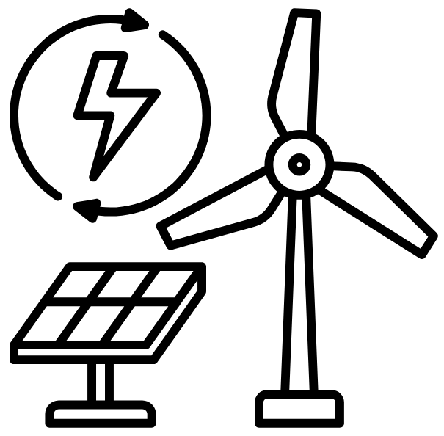
Going Green!
You can buy renewable power. This replaces a row of fossil fuel power, and increases the amount of power
You can buy this on your own or with other players.
Everyone gets to use the power.
It costs eight coins.
8

Slide 43
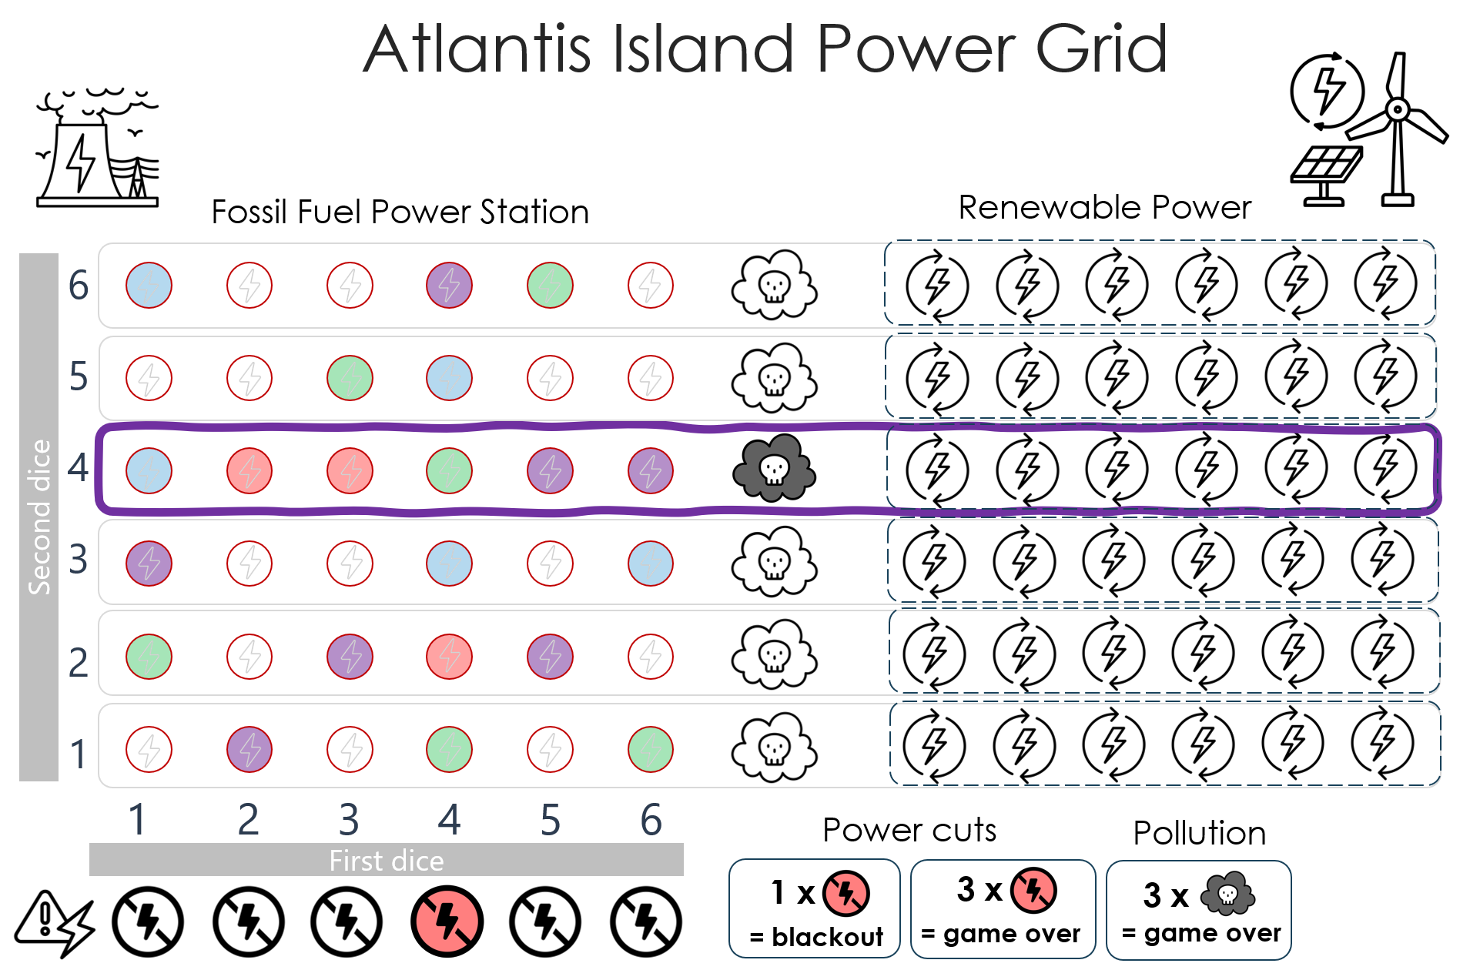
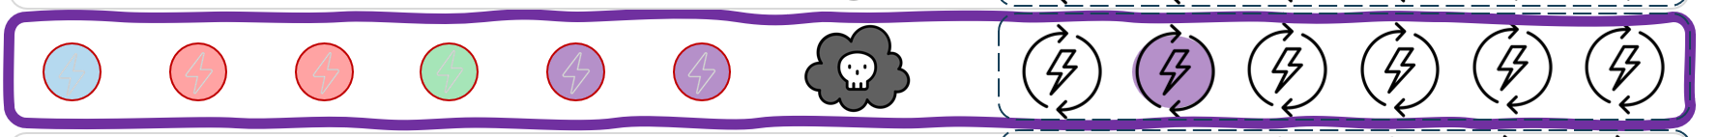

Renewable Power
Draw a line around the whole row that you have chosen.
There is now six more power circles available. Any player can use this power
If the pollution cloud wasn’t filled in, it cannot be filled in now.
Well done – you’ve made the island a bit nicer

Slide 44
Dealing with water shortages
Data Centres require a lot of water to cool the servers. There are some options for dealing with this without using all the water.
There are three ways you can get more water:
Buy swimming pool server cooling
Buy an undersea data centre
Or expand the reservoir

Slide 45
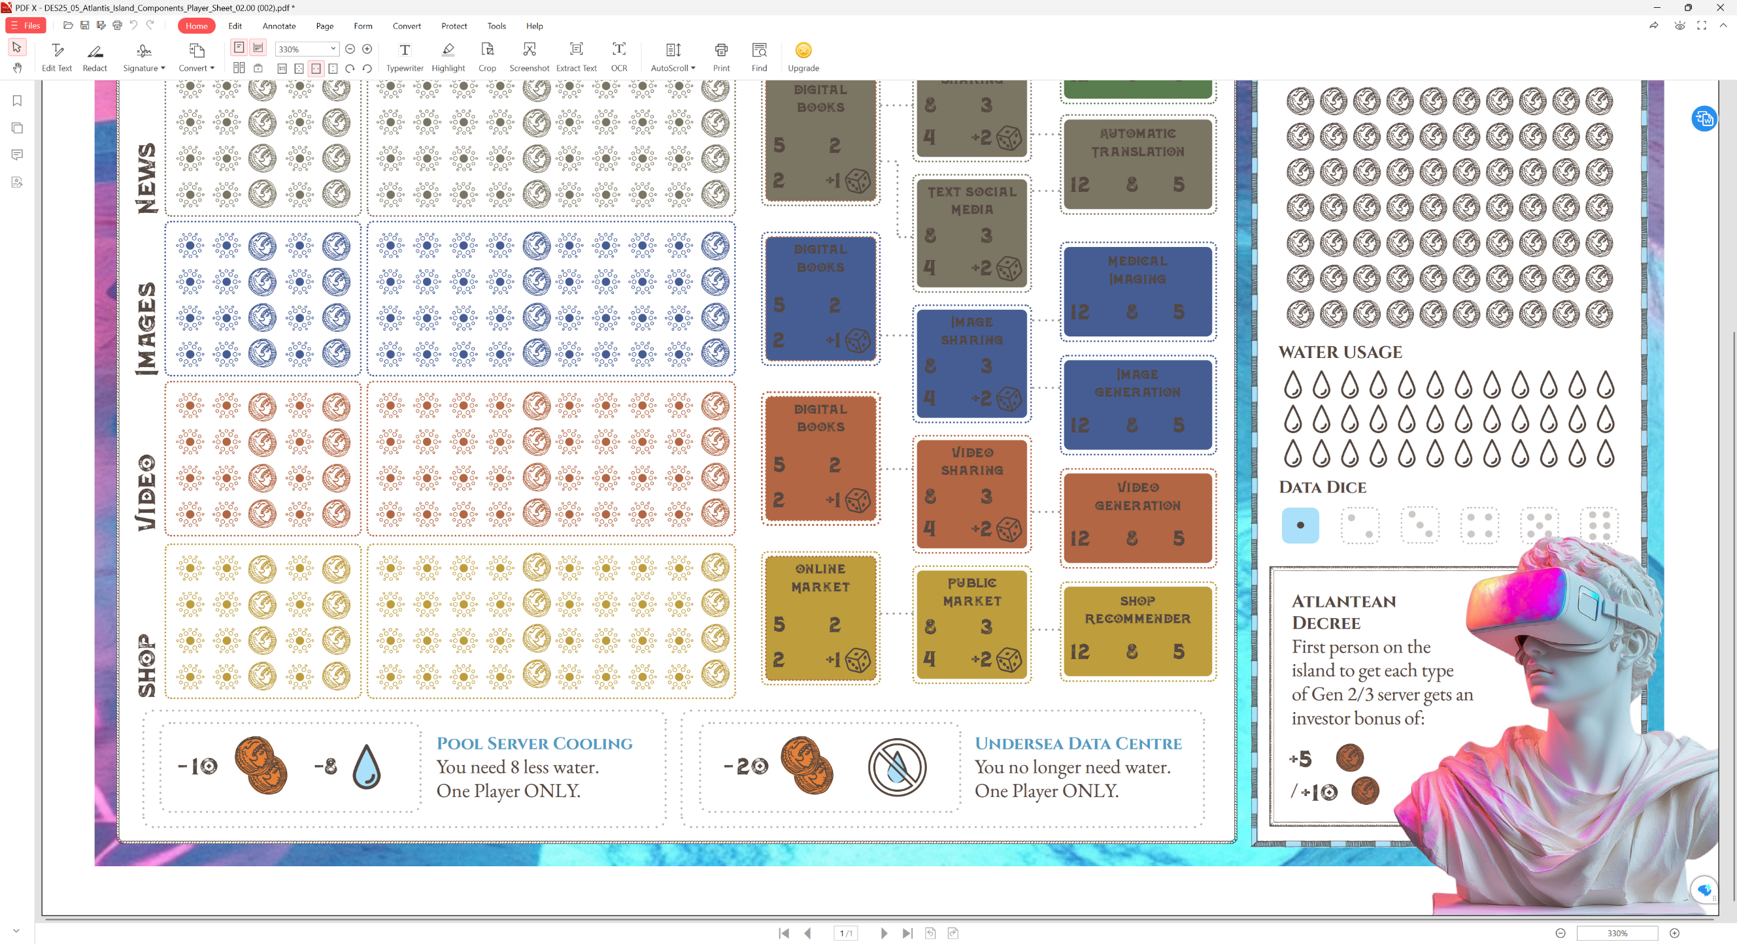
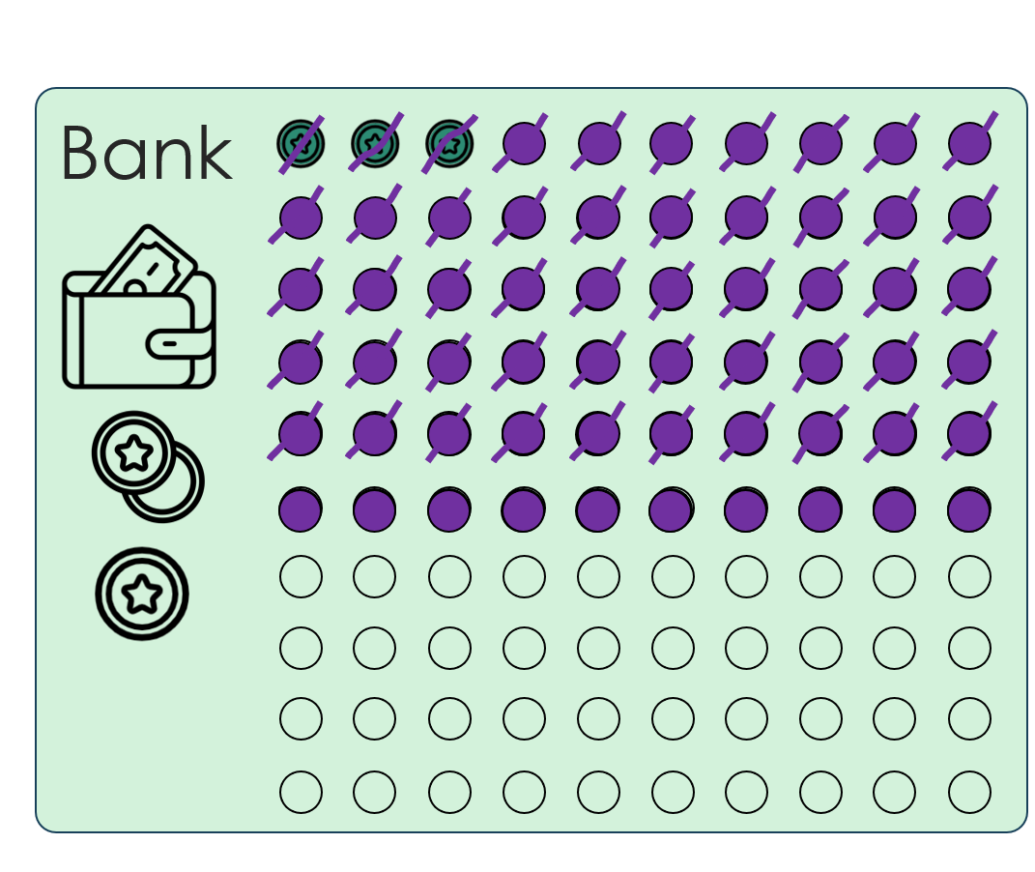


Swimming pool server cooling
You can buy swimming pool server cooling.
This cools the server by heating the pool water.
Water usage
Draw around the pool server box.
Score out 10 coins.
Score out 8 water.
Only one player can buy and use the swimming pool server cooling

Slide 46
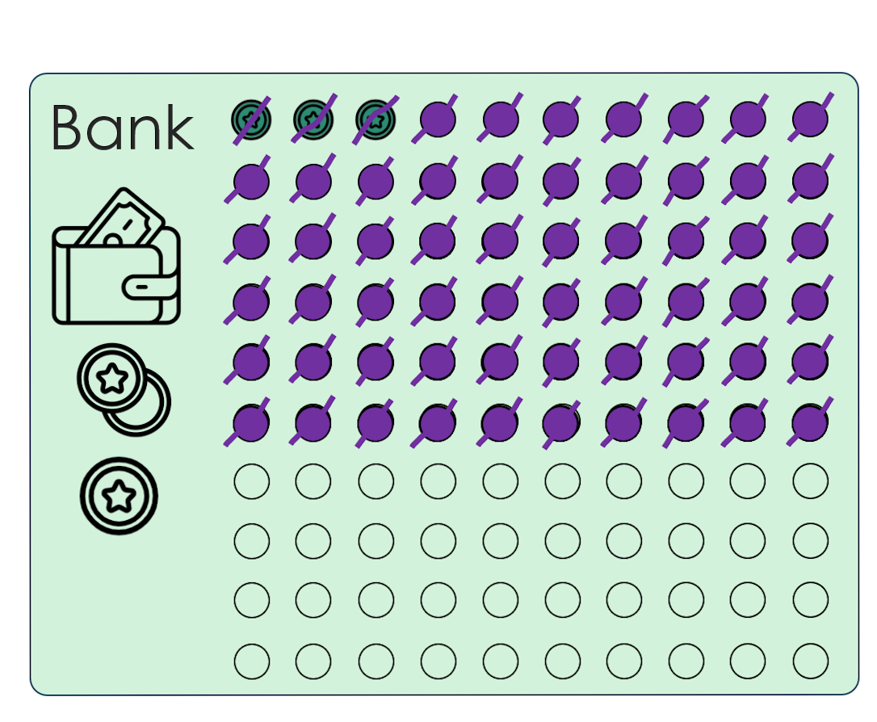
Undersea Data Centre
You can buy an
undersea data centre.
This cools the servers by storing them in cold water.
Water usage
Draw around the undersea data centre box.
Score out 20 coins.
Score out all your water.
Only one player can buy and use the undersea data centre

Slide 47
Reservoir Expansion
You can expand your reservoir by buying more rainwater dice.
Draw around the next water dice box.
Score out 8 coins.
This cost can be shared by the players

Slide 48
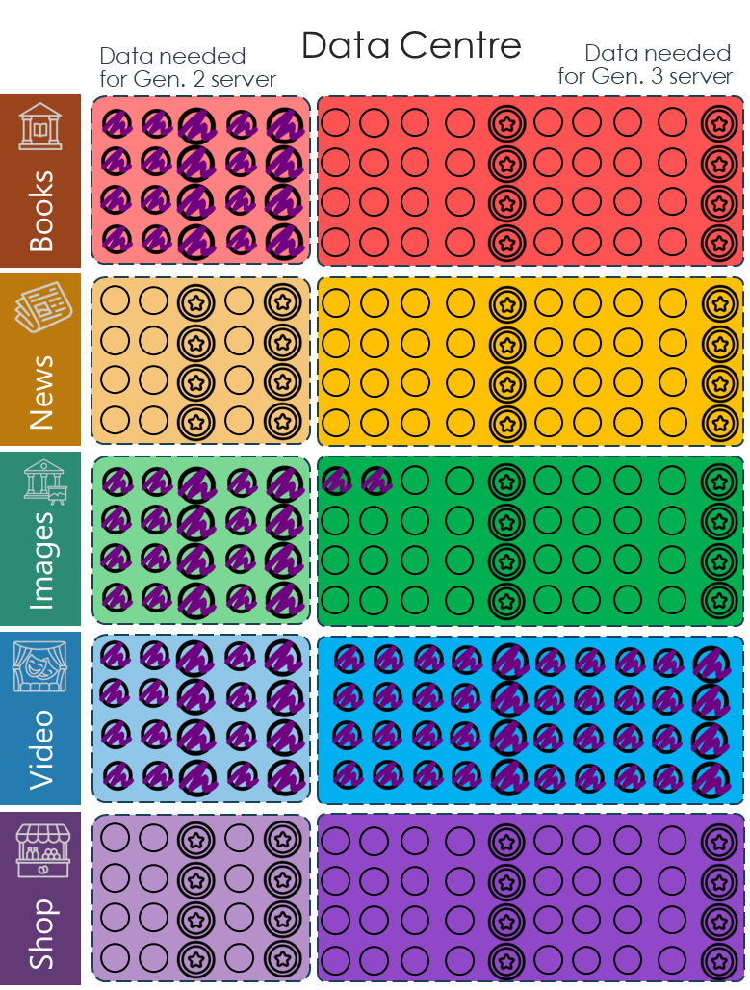
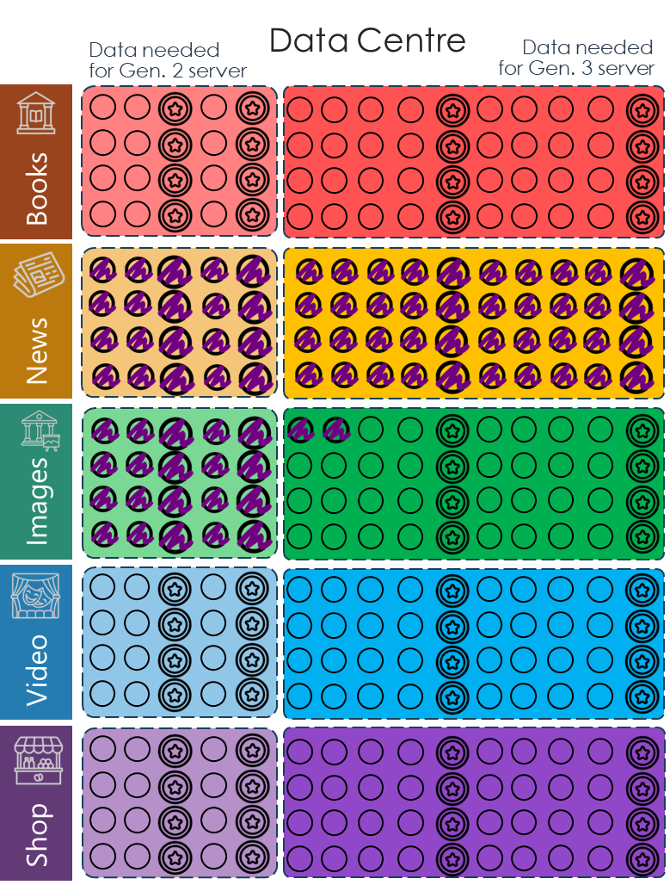
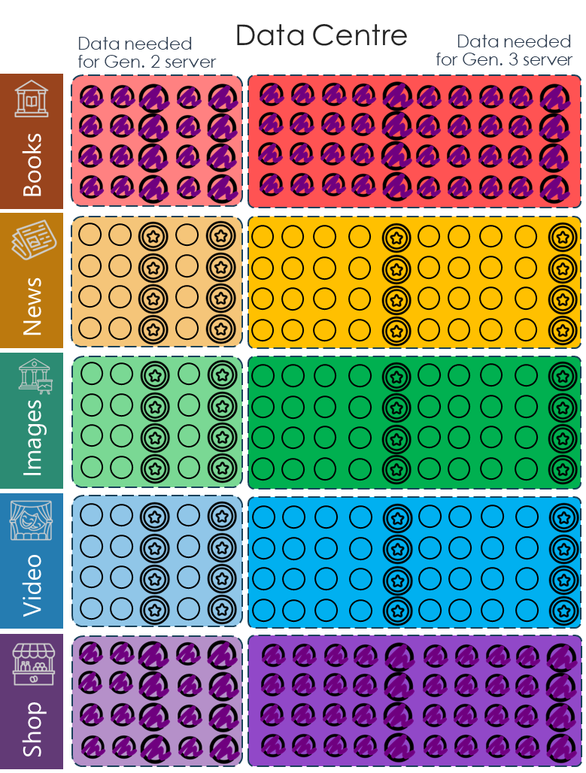
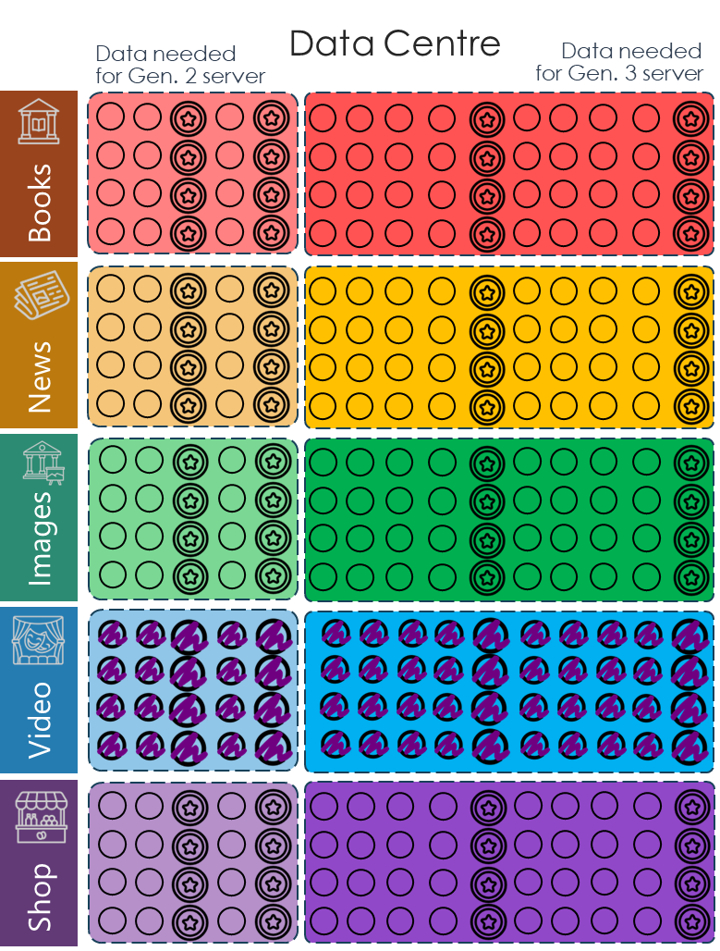

Win the game
Remember to gather
and share enough data!
Together make sure all ten of the Gen 2 and Gen 3 data blocks are complete.
Notes:
Can you work together to digitise and share all of Atlantis Island’s data? Together make sure all ten of the Gen 2 and Gen 3 data blocks are complete between all four players, so that Atlantis’ knowledge is protected and so it is shared with the world.
Good luck!

Slide 49
Continue the game!
Can you get to the end of 12 rounds without destroying the island?
If you haven’t gathered all the data, you could try another round or two to gather the data …but don’t destroy the island!

