Slide 1
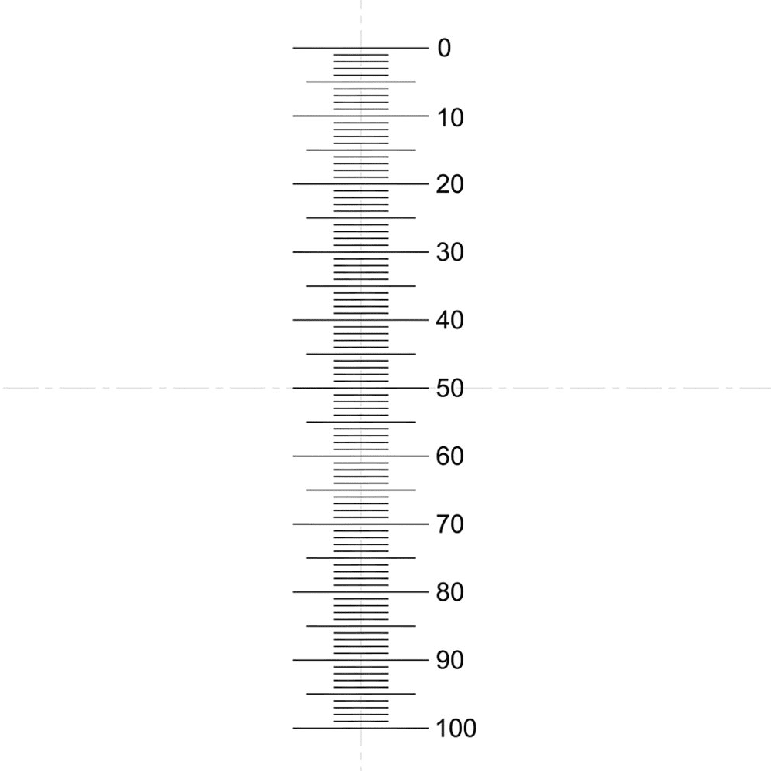
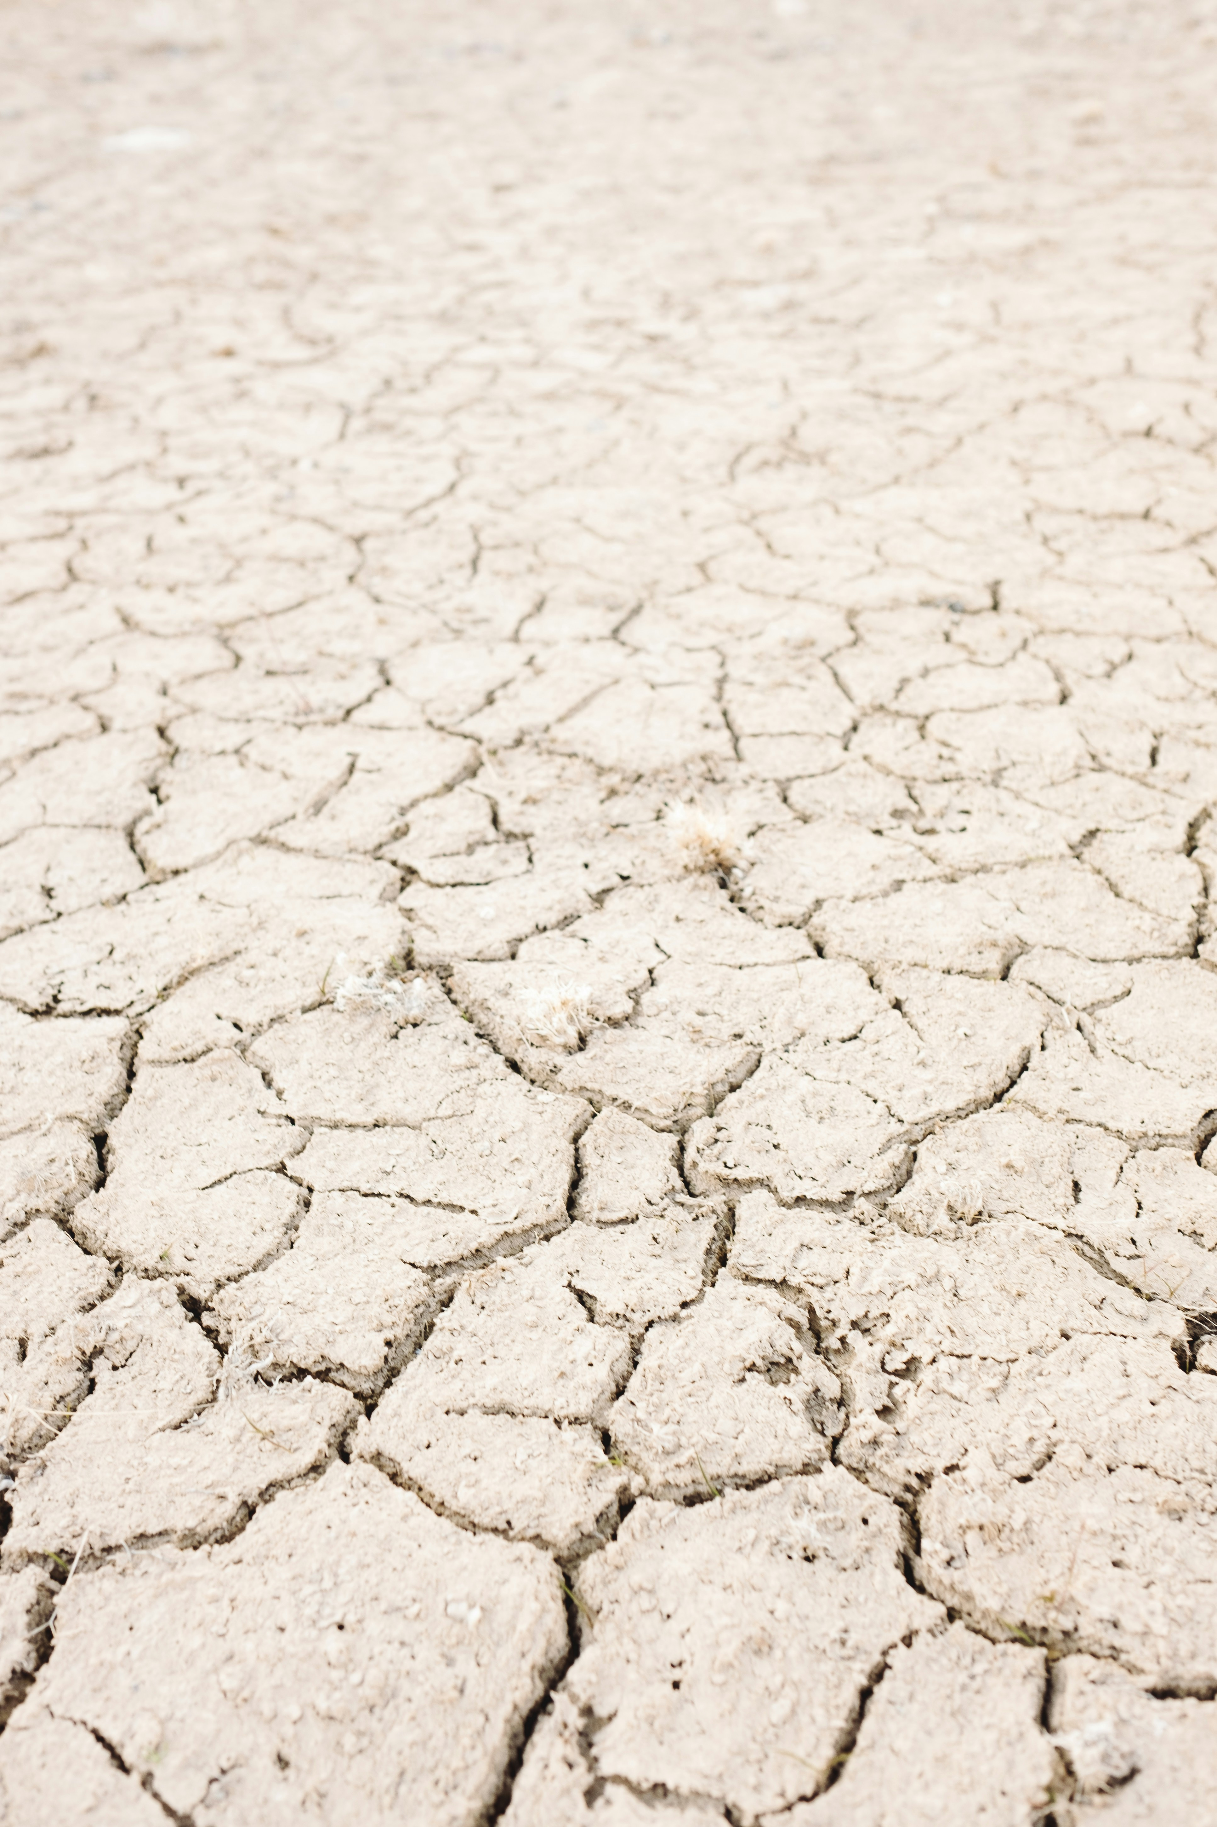

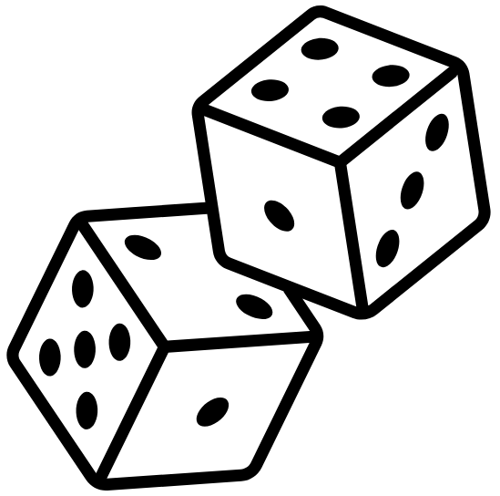

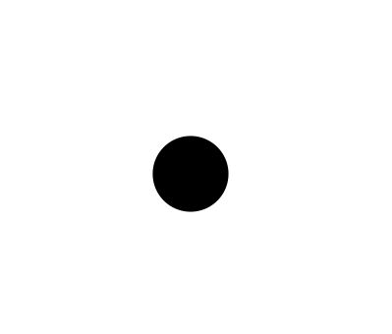
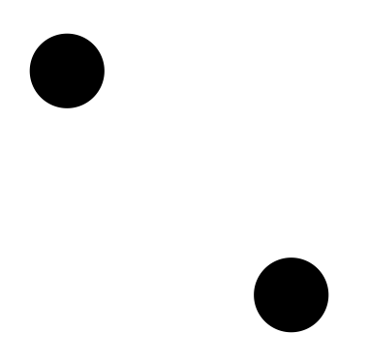
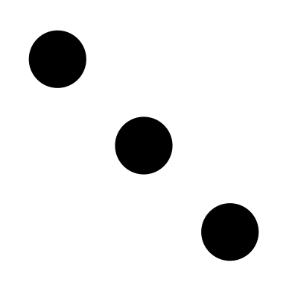


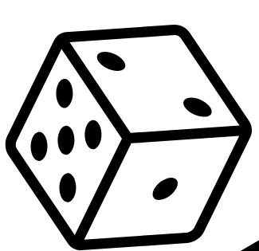

100
90
80
70
60
50
40
30
20
10
0
Reservoir Expansion
Game over if water runs out
Water Dice
+1
16
Add one water dice
Atlantis
Island
Reservoir
Cut along the dotted lines

Slide 2

Atlantis Island Reservoir
Water Level cut-out
Cut along the dotted lines
Put the big water level strip through the other page then stick on the smaller arrow
Stick Water Level
arrow here
Pull up and down
Stick this to the other strip
Water Level

